Slide 1
Great background material for Markov Random Fields from which the Notes below are derived:
Chapters 4 and 20 Koller and Friedman:
Probabilistic Graphical Models: Principles and Techniques
Gould Notes:
https://users.cecs.anu.edu.au/~sgould/papers/part1-MLSS-2011.pdf
**UGM (Schmidt):
https://www.cs.ubc.ca/~schmidtm/Software/UGM.html
**CRF: Port of UGM for R (Wu):
https://cran.r-project.org/web/packages/CRF/index.html
Murphy Chapter 19:
https://www.cs.ubc.ca/~murphyk/MLbook/pml-print3-ch19.pdf
Kschischang et al.:
Factor Graphs and the Sum-Product Algorithm, IEEE Transactions on Information Theory Volume: 47, Issue: 2, pp 498-519, 2001:
https://vision.unipv.it/IA2/Factor%20graphs%20and%20the%20sum-product%20algorithm.pdf

Slide 2
My little add on R package to do some stuff in these Notes can be found at:
To install in R, run the lines:
https://github.com/npetraco/CRFutil
# First install devtools and some packages now only available on Bioconductor
install.packages("devtools")
install.packages("BiocManager")
BiocManager::install("graph", force = TRUE)
BiocManager::install("Rgraphviz", force = TRUE)
BiocManager::install("RBGL", force = TRUE)
# Turn on devtools and install CRFutil from github
# CRFutil should automatically install CRF and gRbase:
library(devtools)
install_github("npetraco/CRFutil")
# Test and see if the CRFutil library loads. No error messages
# is a sign of success. Don't worry about any warning messages.
library(CRFutil)
Note: CRFutil is meant to be pedagogical, not fast…

Slide 3
Table of Contents
Markov Random Fields: Theory and Computation - 4
Maximum Likelihood Approximation for MRF Parameters - 42
Maximum Pseudolikelihood Approximation for MRF Parameters - 87
Multilevel Logistic Regression to Determine MRF Parameters - 162
Log-linear approach to for MRF Parameters - 192
Message passing and belief propagation - 214
XX

Slide 4
Markov Random Field Notes
Theory and Computation

Slide 5
For some joint probability distribution over a set of variables* , Pr(X):
The dependencies between the X_{i} can be represented as a graph.
  An example for a 5-variable distribution Pr(A,B,C,D,E)
A
A 5-variable PMF with dependencies represented by an undirected graph (Markov Random Field or Markov Network)
E
B
D
C
*We’ll assume variables are discrete unless stated otherwise

Slide 6
Parameterize this distribution using unary potentials for each node and pair-wise potentials between each pair of connected nodes*
For the example Pr(A,B,C,D,E) this amounts to replacing the undirected graph with a factor graph
*We’ll assume all MRFs in these notes are parameterized this way unless otherwise stated
Ψ_{A}
A
Ψ_{AE}
Ψ_{AB}
E
B
Ψ_{E}
Ψ_{BE}
Ψ_{B}
Ψ_{AD}
Ψ_{DE}
Ψ_{AC}
Ψ_{BC}
Ψ_{BD}
D
C
Ψ_{D}
Ψ_{BD}
Ψ_{C}

Slide 7
The Ψ_{i} and Ψ_{ij} are factors or potentials. They are functions representable in table form which hold (usually) un-normalized quantities which contribute to the probability distribution:
Ψ_{i} are called unary or node potentials and Ψ_{ij} are called pair or edge potentials.
Edge potentials are known as transfer matrices in statistical physics
Z is the normalization constant called the partition function
For the example Pr(A,B,C,D,E):

Slide 8
It will be convenient to actually parameterize the probability distribution in terms of the logarithms of the potentials*:
*We could have also chosen to define these as negative log potentials.
Making an analogy with physics, log potentials are like energies associated with particles in a many-body system
ψ_{i}: Energies of the particle at node i to be in its various possible states.
In the Ising model of a magnet, the particle is an electron and its possible states are +1 (“spin up”) and -1 (“spin down”) so:

Slide 9
Making an analogy with physics, log potentials are like energies associated with particles in a many-body system (con’t)*
ψ_{ij}: Energies between particles at node i and j which directly feel each other.
In the Ising model:
For these reasons we’ll refer to log potentials as one-body (node) and two-body (edge) energies
*There is a sign choice we are making here. We’ve chosen to define node/edge energies as log potentials. We could just as well have chosen to define them as negative log potentials. Our choice will lead to some differences in the physics versions of the equations down stream.

Slide 10
The variable X_{i} are discrete but can take on any number of states (levels) s_{i}
Ising-like model: Two possible states: {s₁, s₂}
Potts-like model: More than two possible states {s₁, s₂, …, s_{m}}
To computationally operational-ize these ideas, it is convenient to define a “feature function”
w is a vector of weights for each state
I is a vector function which acts like a switch; indicator function
I selects out the weight for the state X_{i} = s_{Xi}
In physics, feature functions are related to spinors which have a deep mathematical theory

Slide 11
As an example, let’s say:
Then:
For the Ising model in physics it’s a little different:
Which leads to feature functions:

Slide 12
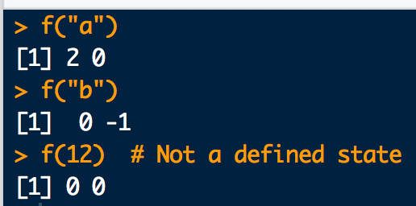
Here is how you can implement feature functions in R:
# Make up some state labels:
s1 <- "a"
s2 <- "b"
# Define a weight vector:
w <- c(2,-1)
# Define feature function:
f <- function(y){ w * as.numeric(c((y==s1),(y==s2))) }
# Try it out:
f("a")
f("b")
# What happens for an undefined state?
f(12)

Slide 13
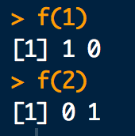
We usually define the feature function this way to work with CRF output:
# State labels used by CRF:
s1 <- 1
s2 <- 2
# Define feature function. State weights are implicitly 1:
f <- function(y){ as.numeric(c((y==s1),(y==s2))) }
# Try it out:
f(1)
f(2)
Compare with example two-slides ago

Slide 14
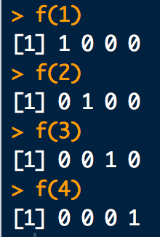
Feature function for a Potts-like model is the same idea:
# Define 4 state labels for a Potts-like model:
s1 <- 1
s2 <- 2
s3 <- 3
s4 <- 4
# Define feature function. State weights are implicitly 1:
f <- function(y){ as.numeric(c((y==s1),(y==s2),(y==s3),(y==s4))) }
# Try it out:
f(1)
f(2)
f(3)
f(4)

Slide 15
Using feature functions, we can write node and edge energies in convenient matrix-vector form(s):
node energies
is called the node i weight vector:
If w = id(m) (all ones vector) then has entries numerically equivalent to node i energies

Slide 16
Using feature functions, we can write node and edge energies in convenient matrix-vector form(s):
edge energies
is called the edge ij weight matrix:
If w = id(m) (all ones vector) then has entries numerically equivalent to edge ij energies
Feature functions play a role similar to spin-orbital one-body basis functions familiar from many-body theory.

Slide 17
For the models considered here, there will only be 2 states at each node. Also, each state has weight 1. That is:
Thus, the node and edge weights are:
The corresponding node and edge energies in table form are:

Slide 18
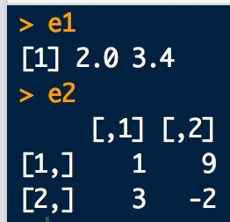
Here is how one and two-body energy calculations can be implemented in R:
# Consider an Ising-like model with:
tau <- c(2, 3.4) # node weights
omega <- rbind( # edge weights
c(1,9),
c(3,-2)
)
# Define states and feature function:
s1 <- 1
s2 <- 2
f <- function(y){ as.numeric(c((y==s1),(y==s2))) }
# one-body energies:
e1 <- c(f(1) %*% tau , f(2) %*% tau)
e1
# two-body energies
e2 <- rbind(
c(f(1) %*% omega %*% f(1), f(1) %*% omega %*% f(2)),
c(f(2) %*% omega %*% f(1), f(2) %*% omega %*% f(2))
)
e2

Slide 19
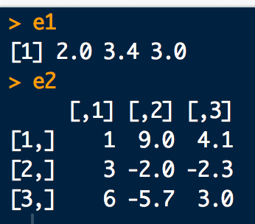
Again, for a Potts-like model things are pretty similar:
#Consider an Potts-like model with node/edge weights:
tau <- c(2, 3.4, 3)
omega <- rbind(
c(1, 9, 4.1),
c(3, -2, -2.3),
c(6, -5.7, 3 )
)
# Define states and feature function:
s1 <- 1
s2 <- 2
s3 <- 3
f <- function(y){ as.numeric(c((y==s1),(y==s2),(y==s3))) }
# one-body energies:
e1 <- c(f(1) %*% tau, f(2) %*% tau, f(3) %*% tau)
e1
# two body energies
e2 <- rbind(
c(f(1) %*% omega %*% f(1), f(1) %*% omega %*% f(2), f(1) %*% omega %*% f(3)),
c(f(2) %*% omega %*% f(1), f(2) %*% omega %*% f(2), f(2) %*% omega %*% f(3)),
c(f(3) %*% omega %*% f(1), f(3) %*% omega %*% f(2), f(3) %*% omega %*% f(3))
)
e2

Slide 20
Finally, the node and edge potentials are:
With these components we can write the full joint probability distribution as:
Note, this is the same for Ising and Potts-like models.

Slide 21
The term in the exponential is the configuration energy E(X)
The sums are not actually sums over vectors/matrices. Rather they are sums of individual one and two-body components of energy corresponding to the states of variables in X.
To make the above formula more explicit:
i < j is implicit
In physics E(•) is called the Hamiltonian

Slide 22
Compute the E(X) for all node state configurations
B
A
C

Slide 23
For this graph, the energy function is:
one-body energy
two-body energy

Slide 24
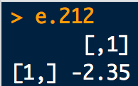
# node weights:
tauA <- c( 1, -1.3)
tauB <- c(-0.85, -2.4)
tauC <- c(3.82, 1.4)
# edge weights:
omegaAB <- rbind(
c( 3.5, -1.4),
c(-1.4, 2.5)
)
omegaBC <- rbind(
c( 2.6, 0.4),
c( 0.4, 2.5)
)
omegaAC <- rbind(
c(-0.6, 1.2),
c( 1.2, -0.6)
)
# Define states and feature function:
s1 <- 1
s2 <- 2
f <- function(y){ as.numeric(c((y==s1),(y==s2))) }
# Enumerate all the state configurations
config.mat <- expand.grid(c(s1,s2),c(s1,s2),c(s1,s2))
colnames(config.mat) <- c("A","B","C")
config.mat
# Energy(A=2,B=1,C=2)
e1.212 <- f(2)%*%tauA + f(1)%*%tauB + f(2)%*%tauC
e2.212 <- f(2)%*%omegaAB%*%f(1) + f(1)%*%omegaBC%*%f(2) + f(2)%*%omegaAC%*%f(2)
e.212 <- e1.212 + e2.212
e.212

Slide 25
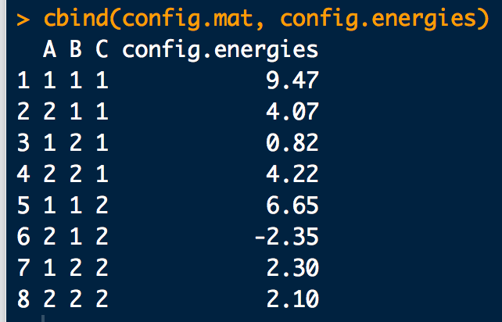
# To cut down on the amount of work we have to do, use CRFutil:
library(CRFutil)
# Define the edge connectivity matrix
edges <- rbind(
c(1,2), #AB
c(1,3), #AC
c(2,3) #BC
)
# Test: CRFutil function to compute a configuration energy.
config.energy(config = c(2,1,2),
edges.mat = edges,
one.lgp = list(tauA,tauB,tauC),
two.lgp = list(omegaAB,omegaAC,omegaBC), # use same order as edges!
ff = f)
# Define a convenience function wrapper:
ener.func <- function(config) {
engy <-config.energy(
config = config,
edges.mat = edges,
one.lgp = list(tauA,tauB,tauC),
two.lgp = list(omegaAB,omegaAC,omegaBC),
ff = f)
return(engy)
}
# Test:
ener.func(c(2,1,2))
# Use to compute all configuration energies:
config.energies <- sapply(1:nrow(config.mat), function(xx){ener.func(config.mat[xx,])})
cbind(config.mat, config.energies)

Slide 26
A short hand, but explicitly parameterized way to write the probability distribution is thus:
*In the Boltzmann distribution, the (not shown) constant term -β usually appears. I’ve implicitly set β = 1. Also, since I defined the node/edge energies as log potentials instead of negative log potentials the minus sign goes away. This is the opposite convention from physics but cuts down on minus signs in formulas down stream.
In physics this is usually called a Boltzmann distribution*. In statistics and machine learning it is usually referred to as a Gibbs distribution
Since E(X) only contains up to two-body terms, this is also called a pair-wise Markov random field.
In order to really be able to use Pr(X), we need to know the partition function Z.
The un-normalized part is a product of potential terms (prodPot**) and is often written as:
**In physics, prodPots are called Boltzmann weights and Boltzmann factors

Slide 27
Sum all prodPots
Z is really hard to get in general because we have to sum over all configurations X. This gets large quickly with increasing number of nodes and increasing number of node-states.
For an Ising-like model with 20 variables there are 2²⁰ = 1048576 explicit terms in Z.
For a Potts-like model with 16 variables and 256 states per node (like a simple 4×4 8-bit image) there are 256¹⁶ = 3.402824… × 10³⁸ explicit terms in Z.
Luckily, if the potentials are known or can be fit, there are various approaches that take advantage the graph structure for Pr(X) which can often be used to exactly or approximately compute Z.

Slide 28
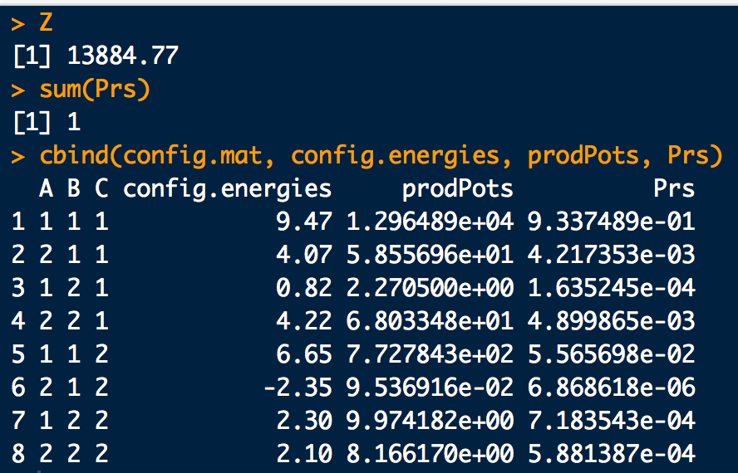
Example: Triangle
# Cf. slide 24 for input
# All configuration energies:
config.energies <- sapply(1:nrow(config.mat), function(xx){ener.func(config.mat[xx,])})
prodPots <- exp(config.energies) # Product Potentials
Z <- sum(prodPots) # The Partition function (by brute force...)
Prs <-prodPots/Z # Configuration probabilities
Z
sum(Prs)
cbind(config.mat, config.energies, prodPots, Prs)
B
A
C
Minor note: Since I chose to define node/edge potentials as log potentials instead of negative log potential in the definition of E(x), the highest prob configs will correspond to the highest config energies. In physics, the opposite is true.

Slide 29
Aside: Energy Sign Convention
In these Notes, I’ve chosen the convention:
The convention in physics however is:
The physics convention ensures lower total energy configurations have higher probability

Slide 30
Aside: Energy Sign Convention
Explicitly, the relationship between the convention in these Notes and physics is:
element-wise inverse

Slide 31

Example: Schmidt Small
  https://www.cs.ubc.ca/~schmidtm/Software/UGM/small.html
#The potentials for Cathy-Heather-Mark-Allison: 1-2-3-4
Psi1 <- c(0.25, 0.75)*4
Psi2 <- c(0.9, 0.1) *10
Psi3 <- c(0.25, 0.75)*4
Psi4 <- c(0.9, 0.1) *10
Psi12 <-
6*rbind(c(2/6, 1/6),
c(1/6, 2/6))
Psi23 <-
6*rbind(c(2/6, 1/6),
c(1/6, 2/6))
Psi34 <-
6*rbind(c(2/6, 1/6),
c(1/6, 2/6))
# Define states and feature function:
s1 <- "right"
s2 <- "wrong"
f <- function(y){ as.numeric(c((y==s1),(y==s2))) }
# Enumerate all the state configurations
config.mat <- expand.grid(c(s1,s2),c(s1,s2),c(s1,s2),c(s1,s2))
colnames(config.mat) <- c("Cathy", "Heather", "Mark", "Alison")

Slide 32
Example: Schmidt Small
  https://www.cs.ubc.ca/~schmidtm/Software/UGM/small.html
library(CRFutil)
# Edge connectivity matrix
edges <- rbind(
c(1,2), # Cathy-Heather
c(2,3), # Heather-Mark
c(3,4) # Mark-Allison
)
# Define a convenience function wrapper:
ener.func <- function(config) {
engy <-config.energy(config = config, edges.mat = edges,
one.lgp = list(log(Psi1),log(Psi2),log(Psi3),log(Psi4)),
two.lgp = list(log(Psi12),log(Psi23),log(Psi34)), ff = f)
return(engy)
}
# All configuration energies:
config.energies <- sapply(1:nrow(config.mat), function(xx){ener.func(config.mat[xx,])})
prodPots <- exp(config.energies)
Z <- sum(prodPots)
Prs <-prodPots/Z
Z
sum(Prs)
cbind(config.mat, config.energies, prodPots, Prs)

Slide 33
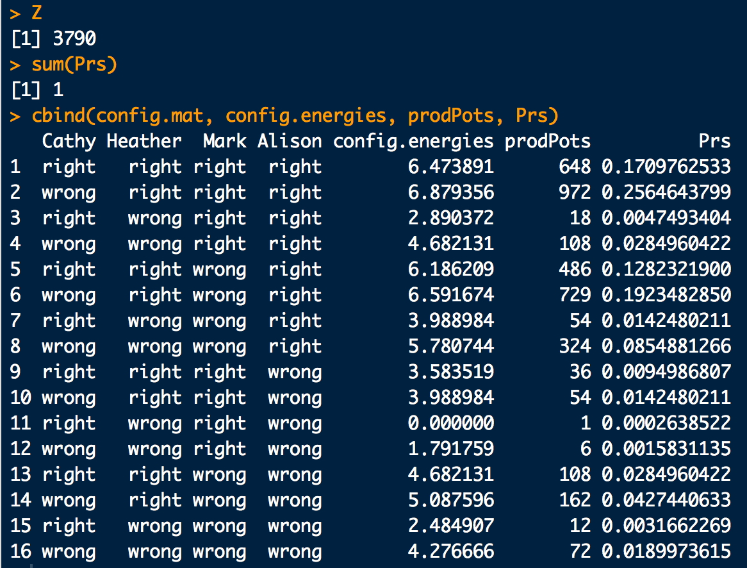
Example: Schmidt Small
  https://www.cs.ubc.ca/~schmidtm/Software/UGM/small.html

Slide 34
Example: Star field, more elaborate example.
A
This time we’ll assign potentials randomly and use CRFutil convenience functions:
E
B
D
C
library(CRFutil)
# Graph formula for Star field:
grphf <- ~A:B+A:C+A:D+A:E+B:C+B:D+B:E+C:D+D:E
# Check the graph:
gp <- ug(grphf, result = "graph")
dev.off()
iplot(gp)
# Adjacenty matrix:
adj <- ug(grphf, result="matrix")
# Define states and feature function:
s1 <- 1
s2 <- 2
f <- function(y){ as.numeric(c((y==s1),(y==s2))) }
# NEW! Make up random potentials and return a CRF-object
star <- sim.field.random(adjacentcy.matrix=adj, num.states=2, num.sims=100, seed=1)$model

Slide 35
Example: Star field, more elaborate example.
# NEW: Get energies from potentials and decorate both with gRbase annotations:
star.params <- make.gRbase.potentials(crf=star, node.names=gp@nodes, state.nmes=c(s1,s2))
star.node.en <- star.params$node.energies
star.edge.en <- star.params$edge.energies
star.node.pot <- star.params$node.potentials
star.edge.pot <- star.params$edge.potentials
# Define states and feature function:
s1 <- 1
s2 <- 2
f <- function(y){ as.numeric(c((y==s1),(y==s2))) }
# Enumerate all the state configurations
config.mat <- expand.grid(c(s1,s2),c(s1,s2),c(s1,s2),c(s1,s2),c(s1,s2))
colnames(config.mat) <- c("A","B","C","D","E")
# NEW: Compute Probs of all configurations and logZ from energies:
dist.en.info <- distribution.from.energies(
state.space = config.mat,
edges.mat = star$edges,
node.energies = star.node.en,
edge.energies = star.edge.en,
energy.func = config.energy,
ff = f)
Pr.en <- dist.en.info$state.probs
Pr.en
# NEW: As a check compute Probs of all configurations and logZ from potentials as well:
dist.pot.info <- distribution.from.potentials(
gRbase.node.potentials = star.node.pot,
gRbase.edge.potentials = star.edge.pot)
Pr.pot <- dist.pot.info$state.probs
Pr.pot

Slide 36
Example: Star field, more elaborate example.
# Check quick to make sure all config energies are the same between the two combination methods:
#library(prodlim)
names(dimnames(Pr.pot))
order(names(dimnames(Pr.pot)))
Pr.pot2 <- as.data.frame(as.table(Pr.pot))
Pr.pot2
gR.idxs <- Pr.pot2[,order(names(dimnames(Pr.pot)))]
# Rearrange gRbase state order to be in the same order as config.mat:
rearrange.idxs <- sapply(1:nrow(config.mat),
function(xx){row.match(config.mat[xx,], table = gR.idxs)})
rearrange.idxs
# Columns the same?
cbind(Pr.pot2[rearrange.idxs,6],Pr.en, Pr.pot2[rearrange.idxs,6]-Pr.en)
# Put in a nice table:
prodPots <- Pr.en*exp(dist.en.info$logZ) # work backwards
config.energies <- log(prodPots) # work backwards
cbind(config.mat, config.energies, prodPots, Pr.en, Pr.pot2[rearrange.idxs,6])

Slide 37
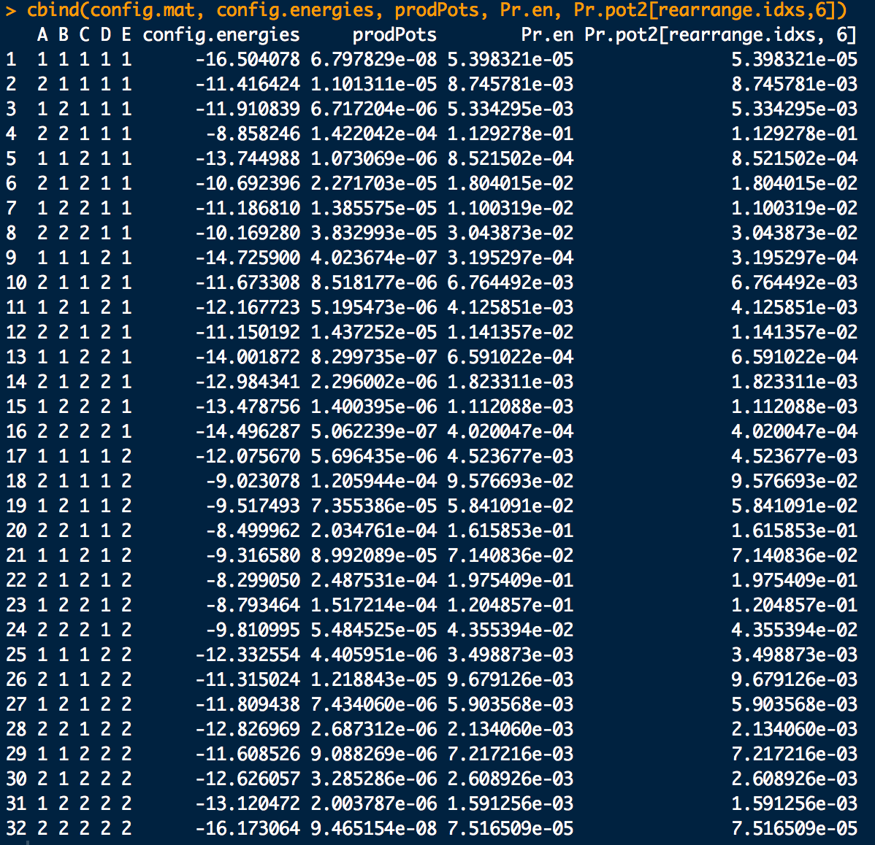
Example: Star field, more elaborate example.

Slide 38
A Note About Parameterization
So, for this work, the major problem is determining the potentials
Parameterization of the potentials is fairly arbitrary:
  Scalar multiplication is associative over the algebra of potentials so they can always be re-scaled to effectively reduce the number of parameters, e.g.:
∘ is multiplication between potentials

Slide 39
A Note About Parameterization
We will usually choose the standard parameterization:
So for node parameters in the standard parameterization:
For edge parameters in the standard parameterization:
We may also choose a slightly more flexible parameterization: for where we allow the freedom for ω_{ij11} ≠ ω_{ij22}:
Note the τ_{i} and ω_{ij} are determined relative to the 0-terms

Slide 40
A Note About Parameterization
Another popular parameterization is the Ising parameterization, but it’s equivalent to the standard parameterization:
For node parameters in the Ising parameterization:
For edge parameters in the Ising parameterization:
If all the node parameters are the same and all the edge parameters are the same, we recover Ising’s original parameterization from statistical mechanics:

Slide 41
A Note About Parameterization
Circling back to our example from three slides ago, under these parameterizations Pr(X) becomes:
general parameterization
standard parameterization
flexible parameterization
∘ is multiplication between potentials

Slide 42
Maximum Likelihood Parameter Estimation
To estimate parameters given data, the standard of practice is to find the Maximum Likelihood Estimate (MLE) or Maximum Pseudo-Likelihood Estimate (MPL).
As an example of MLE consider the triangle model in the standard parameterization:
B
A
C

Slide 43
For this model (as every other MRF):
The log-likelihood for a configuration X is proportional to:
The total log-likelihood for a sample of data of size N (i.e. N X_{i}) is:

Slide 44
Let's say we observe the sample:
X₁ = (1,1,1)
X₂ = (1,2,1)
X₃ = (1,1,1)
The energies of each sampled configuration are:
Thus, the total sample log-likelihood is:

Slide 45

Thus, the total sample log-likelihood is:
MRF sufficient statistics: the number of times each parameter appears in the total log-likelihood
Having a sample of size N and a parameterized MRF model, one can always compute the corresponding vector of sufficient statistics s
for this model
Collecting together the parameters of the MRF into a vector
for this model
we can represent the total log-likelihood as:

Slide 46

Under MLE we find the that maximizes :
The problem is we don’t know Z when we start the calculation…
  We can solve the problem iteratively by re-computing Z after each time we adjust in the process of reaching
Z is prohibitive to re-compute for large networks, but we’ll use this method anyway.
  We need to be careful not to let let the networks get too big…
Before we explore how to implement this maximization, lets explore s in a tad more detail and define what we’ll call a “feature” φ_{k}(X).

Slide 47
A note about the sufficient statistics s:
Let φ_{k}(X) = φ_{k} be the number of times parameter k appears in E(X)
  φ_{k} are indicator variables: φ_{k} = 1 if parameter k appears in E(X) and 0 otherwise.
  φ_{k} is called a “feature” (just to be confusing…). It is not the feature function f(X_{i}), but is related to it (see next slide).
As an example consider X₂ for the triangle network:
with
φ₁(X₂) = φ_{τA}(X₂) = 1
φ₂(X₂) = φ_{τB}(X₂) =0
φ₃(X₂) = φ_{τC}(X₂) =1
φ₄(X₂) = φ_{ωAB}(X₂) =0
φ₅(X₂) = φ_{ωAC}(X₂) =1
φ₆(X₂) = φ_{ωBC}(X₂) =0

Slide 48
Thus, for node parameters τ:
A little extra notation to indicate node i is associated with parameter k. Though i and k are often the same number, they can differ depending on the parameterization scheme.
For edge parameters ω:
A little extra notation for edges to show what nodes are associated with parameter k

Slide 49
Aside: Parameter Index Matrices
It’s a bit confusing (for me at least…) to convert between parameter and node/edge indices.
The “easiest” way I can think of is to exploit the UGM/CRF data structures which must be set up to index the parameterization scheme chosen. They are the parameter index matrices
  In UGM these are called nodeMap and edgeMap
  In CRF these are called node.par and edge.par

Slide 50
Aside: Parameter Index Matrices
We’ll stick with the CRF nomenclature for these things.
Let’s consider an example (weird) parameterization of the triangle model:
X₂
X₁
X₃

Slide 51
Aside: Parameter Index Matrices
node.par (η_{τ}) is a row-stacked matrix of tau-index vectors:
s_{Xi}= ⬆ ⬇
X₁
X₂
X₃
edge.par (ε_{ω}) is an (R) list of omega-index matrices:
X₂:
X₃:
X₃:
⬆ ⬇
⬆ ⬇
⬆ ⬇
X₁:
⬆
⬇
X₁:
⬆
⬇
X₂:
⬆
⬇

Slide 52
Aside: Parameter Index Matrices
Using these parameter index matrices, it is a little more transparent as to how the conversion between parameter and node/edge indices works:
parameter k node i in state X_{i} = s_{Xi}
row i of η_{τ} matrix
parameter k node i in state X_{i} = s_{Xi}
node j in state X_{j}= s_{Xj}
We’ll find this handy later.

Slide 53
Aside: Parameter Index Matrices
For example, under this model/parameterization consider configuration X = (1,2,1):

Slide 54
Aside: Parameter Index Matrices
For example, under this model/parameterization and configuration X = (1,2,1):
From these evaluation we can infer:

Slide 55
Aside: Parameter Index Matrices
Check:
library(CRFutil)
# Graph formula:
grphf <- ~A:B:C
adj <- ug(grphf, result="matrix")
n.states <- 2
fitc <- make.crf(adj, n.states)
fitc <- make.features(fitc)
fitc <- make.par(fitc, 6)
# Parameterization:
fitc$node.par[1,1,] <- 1
fitc$node.par[2,1,] <- 2
fitc$node.par[3,1,] <- 2
fitc$edge.par[[1]][1,1,1] <- 3
fitc$edge.par[[1]][2,2,1] <- 3
fitc$edge.par[[2]][1,1,1] <- 2
fitc$edge.par[[2]][2,2,1] <- 4
fitc$edge.par[[3]][1,1,1] <- 5
fitc$edge.par[[3]][2,2,1] <- 6
fitc$edges
fitc$node.par
fitc$edge.par
# Node numbers
X <- c(1,2,1)
s1<-1
s2<-2
f0 <- function(y){ as.numeric(c((y==1),(y==2)))} # Feature function

Slide 56
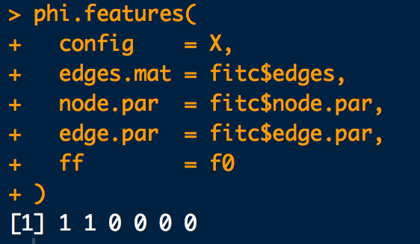
Aside: Parameter Index Matrices
Check:
# Compute phi for this configuration using CRFutil:
phi.features(
config = X,
edges.mat = fitc$edges,
node.par = fitc$node.par,
edge.par = fitc$edge.par,
ff = f0
)

Slide 57
Using “features” we can express the probability of a configuration X equivalently as:
Note the correspondence:
feature formulation
feature function formulation
I don’t like the feature formulation as much because it hides a lot of structure. That said, it is more compact and more common in the literature.

Slide 58

Arranging a vector of of φ_{i}’s in rows, one-row for each configuration X, gives a “model matrix” for an MRF with w total parameters and N realized configurations:
θ₁
θ₂
θ_{w}
X₁
X₂
X_{N}
Summing down the columns of M gives the sufficient statistics s:

Slide 59
Example:
a. Check the equivalence for a Star field: Show for each possible outcome for X (i.e. all possible configurations) the energies computed are the same:
vs.
library(CRFutil)
# First set up a Star field with known potentials with which to generate a sample of X:
grphf <- ~A:B+A:C+A:D+A:E+B:C+B:D+B:E+C:D+D:E
gp <- ug(grphf, result = "graph")
dev.off()
iplot(gp)
adj <- ug(grphf, result="matrix")
adj
n.states <- 2
star <- sim.field.random(adjacentcy.matrix=adj, num.states=n.states, num.sims=1000,seed=1)
# A sample of X for which we will fit a model and obtain a theta:
samps <- star$samples
known.model <- star$model

Slide 60
# Fit an MRF to the sample with the intention of obtaining a theta
# Use the standard parameterization:
fit <- make.crf(adj, n.states)
fit <- make.features(fit)
fit <- make.par(fit, 14)
# One param per node:
for(i in 1:nrow(fit$node.par)){
fit$node.par[i,1,1] <- i
}
fit$node.par
# Edge parameterization:
fit$edges # Check edge order first!
fit$edge.par[[1]][1,1,1] <- 6
fit$edge.par[[1]][2,2,1] <- 6
fit$edge.par[[2]][1,1,1] <- 7
fit$edge.par[[2]][2,2,1] <- 7
fit$edge.par[[3]][1,1,1] <- 8
fit$edge.par[[3]][2,2,1] <- 8
fit$edge.par[[4]][1,1,1] <- 9
fit$edge.par[[4]][2,2,1] <- 9
fit$edge.par[[5]][1,1,1] <- 10
fit$edge.par[[5]][2,2,1] <- 10
fit$edge.par[[6]][1,1,1] <- 11
fit$edge.par[[6]][2,2,1] <- 11
fit$edge.par[[7]][1,1,1] <- 12
fit$edge.par[[7]][2,2,1] <- 12
fit$edge.par[[8]][1,1,1] <- 13
fit$edge.par[[8]][2,2,1] <- 13
fit$edge.par[[9]][1,1,1] <- 14
fit$edge.par[[9]][2,2,1] <- 14
fit$edge.par

Slide 61
# Fit model to samples from the known model and obtain an estimate for theta:
train.mrf(fit, samps, nll=mrf.exact.nll, infer.method = infer.exact)
fit$par.stat
theta <- fit$par
theta
# Shift potentials to match the order in node.par and edge.par:
# train.mrf() probably re-centered them. We need to do this to check the two ways of
# computing the energies.
shift.pots(fit)
# Define states and feature function:
s1 <- 1
s2 <- 2
f <- function(y){ as.numeric(c((y==s1),(y==s2))) }
# Enumerate all the state configurations
all.configs <- expand.grid(c(s1,s2),c(s1,s2),c(s1,s2),c(s1,s2),c(s1,s2))
colnames(all.configs) <- gp@nodes
all.configs
# All configuration energies computed the usual way with feature functions:
fit.params.info <- make.gRbase.potentials(fit, node.names=gp@nodes, state.nmes=c(s1,s2))
config.energies <- sapply(1:nrow(all.configs),
function(xx){
config.energy(config = all.configs[xx,], edges.mat = fit$edges,
one.lgp = fit.params.info$node.energies,
two.lgp = fit.params.info$edge.energies,
ff = f)
})

Slide 62
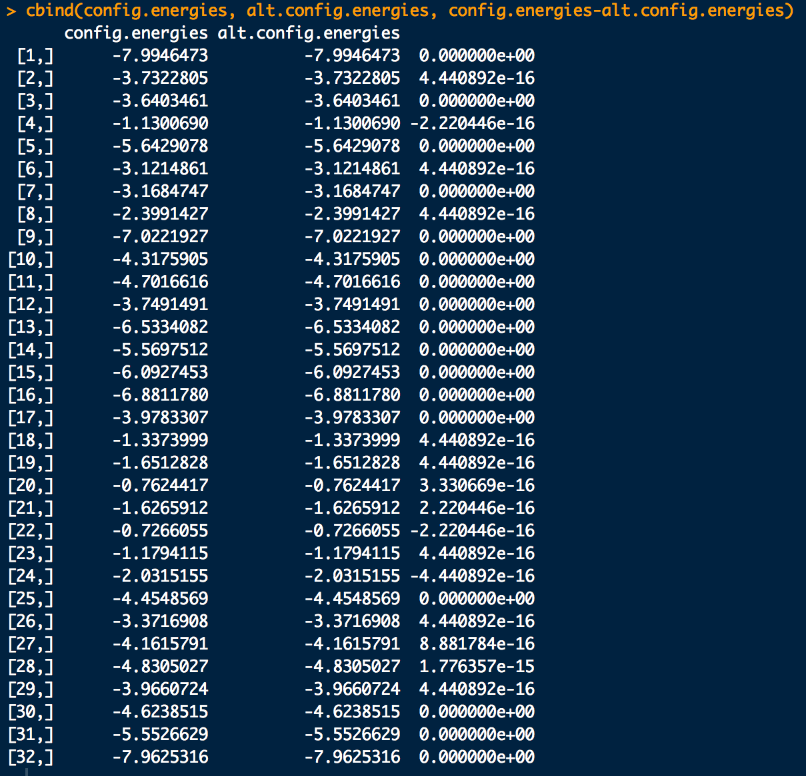
# Compare config energies with energies computed as theta \dot phi:
# First compute the features (phi) for all each possible configuration
M.all <- compute.model.matrix(all.configs, fit$edges, fit$node.par, fit$edge.par, f)
# Now get the energy of each config with the dot-product formula:
alt.config.energies <- sapply(1:nrow(M.all), function(xx){w%*%M.all[xx,]})
config.energies # Check: All config energies with feature functions
alt.config.energies # Check: All config energies with features
config.energies - alt.config.energies # Check: Differences
cbind(config.energies, alt.config.energies, config.energies-alt.config.energies)

Slide 63
If all possible configurations are contained in M then dividing each s_{i} by the number of rows in M gives the expected number of “features” (remember φ is not feature functions f()):
vector of expected number of features
For Ising-like models, the elements are:
For Potts-like models, the elements are:
  If we have values for all θ_{i} and can get Z we can also use:

Slide 64
Example:
a. Compute the expected number of features for the triangle model within the standard parameterization.
library(CRF)
library(gRbase)
# Put together MRF model:
grphf <- ~A:B + B:C + C:A
gp <- ug(grphf, result = "graph")
dev.off()
iplot(gp)
adj <- ug(grphf, result="matrix")
adj
n.states <- 2
triangle.mrf <- make.crf(adj, n.states)
triangle.mrf <- make.features(triangle.mrf)
triangle.mrf <- make.par(triangle.mrf, 6)
triangle.mrf$node.par[1,1,1] <- 1 # Represents tauA
triangle.mrf$node.par[2,1,1] <- 2 # Represents tauB
triangle.mrf$node.par[3,1,1] <- 3 # Represents tauC
triangle.mrf$edges # Check edge order first!
triangle.mrf$edge.par[[1]][1,1,1] <- 4 # Represents omegaAB
triangle.mrf$edge.par[[1]][2,2,1] <- 4
triangle.mrf$edge.par[[2]][1,1,1] <- 5 # Represents omegaAC
triangle.mrf$edge.par[[2]][2,2,1] <- 5
triangle.mrf$edge.par[[3]][1,1,1] <- 6 # Represents omegaBC
triangle.mrf$edge.par[[3]][2,2,1] <- 6
triangle.mrf$node.par
triangle.mrf$edge.par
B
A
C

Slide 65
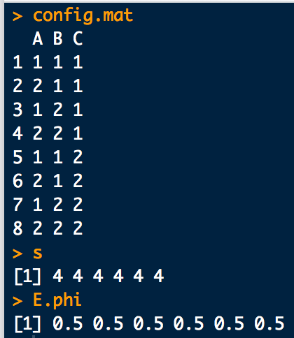
# Define states and feature function:
s1 <- 1
s2 <- 2
f <- function(y){ as.numeric(c((y==s1),(y==s2))) }
# Enumerate all the state configurations
config.mat <- expand.grid(c(s1,s2),c(s1,s2),c(s1,s2))
colnames(config.mat) <- c("A","B","C")
config.mat
# Compute sufficient statistics for all configurations:
s <- mrf.stat(triangle.mrf, instances = as.matrix(config.mat))
s
# Compute expexted number of features:
num.nodes <- length(gp@nodes)
E.phi <- s/2^num.nodes
E.phi

Slide 66
If we have a sample of N configurations, doing the same thing gives the average number of features:
For Ising and Potts-like models, the elements are:

Slide 67
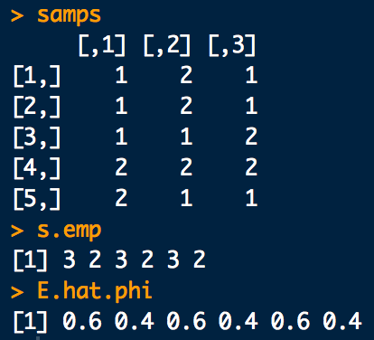
Example:
b. Say we get a sample of size 5 (5 realizations of X). Compute the average number of features (i.e. the empirical estimate for )
# Continuing from a:
# Sample of Xs:
set.seed(1)
N <- 5
samps <- sample.exact(triangle.mrf, size = N)
samps
# Sufficient statistics from the sample:
s.emp <- mrf.stat(triangle.mrf, instances = samps)
s.emp
E.hat.phi <- s.emp/N
E.hat.phi

Slide 68
Example:
c. Let's say we get a sample of size 100 (100 realizations of X) and estimate the parameters for the model: . Compute the expected number of features under this estimate: .
First, note:
and
-or-

Slide 69
library(CRFutil)
# Put together known MRF model and get a sample from it:
grphf <- ~A:B + B:C + C:A
gp <- ug(grphf, result = "graph")
adj <- ug(grphf, result="matrix")
# Make up some potentials and get a sample of size 100:
num.samps <- 100
n.states <- 2
tri.modl <- sim.field.random(adjacentcy.matrix=adj, num.states=n.states, num.sims=num.samps, seed=1)
samps <- tri.modl$samples
known.model <- tri.modl$model
mrf.sample.plot(samps)
# Using the sample, fit a model in the standard parameterization to obtain a theta:
fit <- make.crf(adj, n.states)
fit <- make.features(fit)
fit$node.par # Node parameter index matrix (empty)
fit$edge.par # Edge parameter index matrices (empty)
fit <- make.par(fit, 6)
# Fill the parameter index matrices with the standard parameterization
# Standard parameterization, one param per node:
for(i in 1:nrow(fit$node.par)){
fit$node.par[i,1,1] <- i
}
fit$node.par # Check
# Standard parameterization, edge parameterization:
fit$edges # Check edge order first!
fit$edge.par[[1]][1,1,1] <- 4
fit$edge.par[[1]][2,2,1] <- 4
fit$edge.par[[2]][1,1,1] <- 5
fit$edge.par[[2]][2,2,1] <- 5
fit$edge.par[[3]][1,1,1] <- 6
fit$edge.par[[3]][2,2,1] <- 6
fit$edge.par # Check

Slide 70
# Fit model to samples from the known model and obtain an estimate for theta:
train.mrf(fit, samps, nll=mrf.exact.nll, infer.method = infer.exact)
fit$par.stat # Sample sufficient statistics: total number of appearances of each parameter in the sample
theta <- fit$par # \hat{theta}
theta
# The mrf.update() function within train.mrf() switches the order of the parameters.
# Shift potentials back to be in the same order as in node.par and edge.par.
# If they are not in the same order prodPots will differ depending on the formula used to compute them.
# Only necessary for the testing purposes presented here:
shift.pots(fit)
# Compute marginals and Z (inference). We just need Z at this point though:
infr.info <- infer.exact(fit)
# Define states and feature function:
s1 <- 1
s2 <- 2
f <- function(y){ as.numeric(c((y==s1),(y==s2))) }
# Enumerate all possible configurations X and compute their phi vectors:
# Note: Generally you don't want to do this for larger networks...
X.all <- expand.grid(c(s1,s2),c(s1,s2),c(s1,s2))
M.all <- compute.model.matrix(X.all, fit$edges, fit$node.par, fit$edge.par, f)
# Compute exp(E(X)) for all X as exp(\hat{theta} \dot phi(X)):
prodPots <- sapply(1:nrow(M.all), function(xx){exp(theta %*% M.all[xx,])})
prodPots
#Compute config probs:
Prs <- (1/exp(infr.info$logZ)) * prodPots
Prs
sum(Prs) # Check
# Finally compute E_{\hat{\theta}_i}[phi_i(X)] = \sum_X \phi_i(X) \Pr(X)
E.hattheta.phi <- colSums(sapply(1:ncol(M.all), function(xx){M.all[,xx] * Prs})) # Estimate at the optimal theta
hatE.theta.phi <- fit$par.stat/num.samps # Empirical estimate: \hat{E}_{\theta_i}[\phi_i]
grad <- hatE.theta.phi - E.hattheta.phi # gradient at the optimum theta
cbind(E.hattheta.phi,hatE.theta.phi,grad)

Slide 71
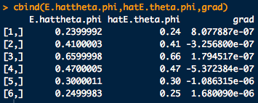
We’ll talk about this one later

Slide 72
A problem that still persists is how to compute without having to generate all X?!
We can use the node and edge marginals from the propagated network:
Turns out is approximately equal to:
If is a node parameter
If your program spits out node potentials instead of energy matrices
If is an edge parameter
If your program spits out edge potentials instead of energy matrices

Slide 73
Example:
Using the same triangle network, from a sample of size 100 compute the expected number of features , this time with the node and edge marginals.
# Cf. Input from slide 55
# Gets your theta:
train.mrf(fit, samps, nll=mrf.exact.nll, infer.method = infer.exact)
# Compute marginals:
infr.info <- infer.exact(fit)
node.bels <- infr.info$node.bel
edge.bels <- infr.info$edge.bel
# Compute node components of the mean:
node.phi.means <- array(0,fit$n.nodes)
for(i in 1:nrow(fit$node.par)){
for(j in 1:ncol(fit$node.par)) {
node.phi.means[i] <- node.phi.means[i] + infr.info$node.bel[i,j] * (1 - fit$node.par[i,j,1]<=0)
}
}
# Compute edge components of the mean:
edge.phi.means <- array(0,fit$n.edges)
for(k in 1:fit$n.edges){
for(i in 1:nrow(fit$edge.par[[k]])){
for(j in 1:ncol(fit$edge.par[[k]])) {
edge.phi.means[k] <- edge.phi.means[k] + edge.bels[[k]][i,j] * (1 - fit$edge.par[[k]][i,j,1]<=0)
}
}
}
c(node.phi.means, edge.phi.means)

Slide 74
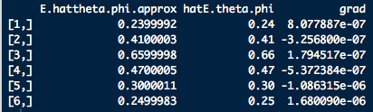
But this time, direct calculation from the marginals. Avoids enumerating all X!

Slide 75
The reason why it is worth bothering to know anything about:
is because it is really advantageous to be able to compute gradients of analytically when finding the MLE:
The gradient of this log likelihood turns out to be:
Since at the max: , iteratively working towards the maximum of the log likelihood should eventually give a parameter estimate which satisfies:

Slide 76
Example: Given a sample from the Koller-Friedman “Misconception” MRF:
  Find an optimal set of parameters . Use the “more flexible” parameterization.
  a. To do this, write a function(s) to compute the gradient of the negative log likelihood:
b. Use your gradient function with optim (see train.mrf in CRF for clues) to minimize the negative log likelihood:

Slide 77
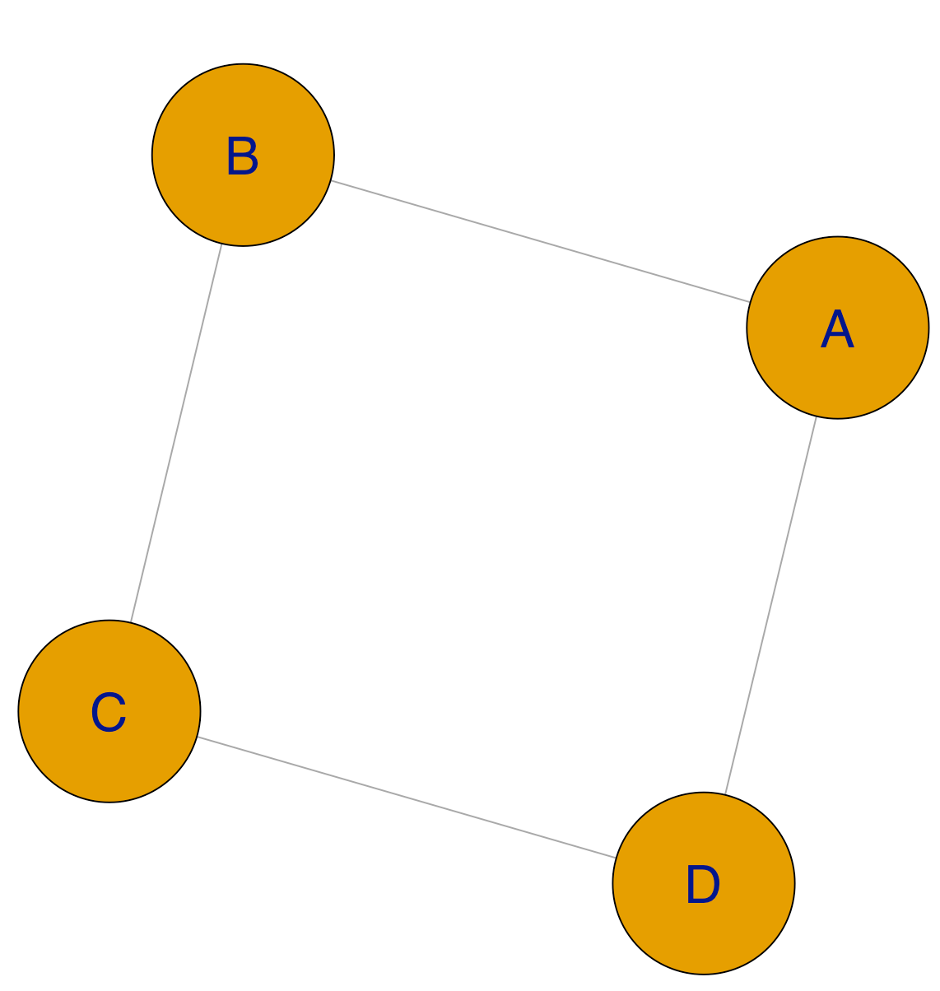
library(CRFutil)
# Put together the Koller-Freidman "Misconception" MRF model and get a sample from it:
grphf <- ~A:B + B:C + C:D + D:A
gp <- ug(grphf, result = "graph")
dev.off()
iplot(gp)
adj <- ug(grphf, result="matrix")
n.states <- 2
known.model <- make.crf(adj, n.states)
# Node pots in original Misconception example are all 1 so no need to initialize them.
# Edge pots in the Misconception example:
PsiAB <- rbind(
c(30, 5),
c(1, 10))
PsiBC <- rbind(
c(100, 1),
c(1, 100))
PsiCD <- rbind(
c(1, 100),
c(100, 1))
PsiDA <- rbind(
c(100, 1),
c(1, 100))
known.model$edges # Check edge order!
known.model$edge.pot[[1]] <- PsiAB
known.model$edge.pot[[2]] <- PsiDA
known.model$edge.pot[[3]] <- PsiBC
known.model$edge.pot[[4]] <- PsiCD
known.model$node.pot
known.model$edge.pot

Slide 78
# So now sample from the model as if we obtained an experimental sample:
num.samps <- 50
set.seed(1)
samps <- sample.exact(known.model, num.samps)
# Let's go bananas and use the more flexible parameterization for the model we'll fit.
# Also we will assume the node parameters are not all 0. This will
# require 1 param per node (4 node params) and 2 params per edge
# (2*4 = 8 edge params) for a total of 12 parameters.
# Initialize the fit model:
fit <- make.crf(adj, n.states)
fit <- make.features(fit)
fit <- make.par(fit, 12)
# Fill the parameter index matrices with the standard parameterization
# Standard parameterization, one param per node:
for(i in 1:nrow(fit$node.par)){
fit$node.par[i,1,1] <- i
}
fit$node.par
# Use the more flexible edge parameterization:
fit$edges # Check edge order first!
fit$edge.par[[1]][1,1,1] <- 5
fit$edge.par[[1]][2,2,1] <- 6
fit$edge.par[[2]][1,1,1] <- 7
fit$edge.par[[2]][2,2,1] <- 8
fit$edge.par[[3]][1,1,1] <- 9
fit$edge.par[[3]][2,2,1] <- 10
fit$edge.par[[4]][1,1,1] <- 11
fit$edge.par[[4]][2,2,1] <- 12
fit$edge.par

Slide 79
We’ll do this more complicated computational job in a few pieces. For the gradient:
Let’s first focus on writing a better function to compute the expected number of features (for our first shot on this, cf. slide 69)
We can get the sufficient statistics already

Slide 80
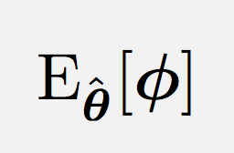
# Package up computation of expected number of features:
feature.means <- function(crf, inference.func = infer.exact) {
# Compute \text{E}_{\hat{\theta}_i}[{\phi_i}] with marginals at an est. of theta.
# Use "inference" to avoid computing X and Z directly.
inference.info <- inference.func(crf)
# Flatten node parameter index matrix into a vector
nodeMap <- as.numeric(crf$node.par[,,])
# Flatten edge parameter index matries into a vector
edgeMap <- unlist(crf$edge.par)
num.params <- crf$n.par
# Flatten node marginals matrix into a vector
nodeBel <- as.numeric(inference.info$node.bel)
# Flatten edge marginals matrices into a vector
edgeBel <- unlist(inference.info$edge.bel)
param.phi.means <- numeric(num.params)
for(i in 1:num.params) {
if(i %in% nodeMap) {
param.idxs <- which(nodeMap == i) # indices for parameter i
param.phi.means[i] <- sum(nodeBel[param.idxs])
}
if(i %in% edgeMap) {
param.idxs <- which(edgeMap == i) # indices for parameter i
param.phi.means[i] <- sum(edgeBel[param.idxs])
}
}
return(param.phi.means)
}

Slide 81
Next put the pieces together for the gradient:
# Package up computation of gradient for the negative log likelihood:
grad.negloglik <- function(crf, nInstances, suffStat, inference.func = infer.exact) {
# First term of the gradient:
num.features.est <- nInstances * feature.means(crf, inference.func)
# Second term of the gradient:
emp.num.features <- suffStat
grd <- num.features.est - emp.num.features
return(grd)
}

Slide 82
Finally let’s put together computation of the negative log likelihood along with its gradient in a way that will be easier for the optim function to take as input:
# Package up computation of nll and gradient:
negloglik <- function(w, crf, samples, infer.method = infer.exact) {
# Make potentials with the parameter vector passed in.
# Store in crf object for use with infer.method
# They are needed to get the Z corresponding to w passed in!
mpots <- make.pots(w, crf, rescaleQ = F, replaceQ = T) # In CRFutil
# Compute logZ:
infer.info <- infer.method(crf)
logZZ <- infer.info$logZ
# Compute neg log likelihood:
nInstances <- nrow(samples)
suffStat <- crf$par.stat
nllk <- -w %*% suffStat + nInstances * infer.info$logZ
# Compute gradient of neg log likelihood, just like in mrf.XXXX.nll() of CRF:
grad <- grad.negloglik(crf, nInstances, suffStat, infer.method)
# All needed for optim. Store in crf object:
crf$par <- w
crf$nll <- nllk
crf$gradient <- grad
return(nllk)
}

Slide 83
OK! Now we’re ready to compute:
# First compute the sufficient stats needed by the likelihood and its’ grad
fit$par.stat <- mrf.stat(com, samps)
# Auxiliary, gradient convenience function. Follows train.mrf in CRF:
gradient <- function(par, crf, ...) { crf$gradient }
# Lets use loopy-belief (lbp) to compute any needed inference quantities (Z and Bels)
# I had to run optim 3-times to reach convergence with LBP:
infr.meth <- infer.lbp # inference method needed for Z and marginals calcs
opt.info <- stats::optim( # optimize parameters
par = fit$par, # theta
fn = negloglik, # objective function
gr = gradient, # grad of obj func
crf = fit, # passed to fn/gr
samples = samps, # passed to fn/gr
infer.method = infr.meth, # passed to fn/gr
update.crfQ = TRUE, # passed to fn/gr
method = "L-BFGS-B",
control = list(trace = 1, REPORT=1))
opt.info$convergence
opt.info$message
fit$gradient
fit$nll
# Examine the gradient terms at the minimum in more detail:
N.E.hat.theta.phi <- num.samps * feature.means(fit, infr.meth)
s <- fit$par.stat
grad <- E.hat.theta.phi - s
cbind(N.E.hat.theta.phi, s, grad)

Slide 84
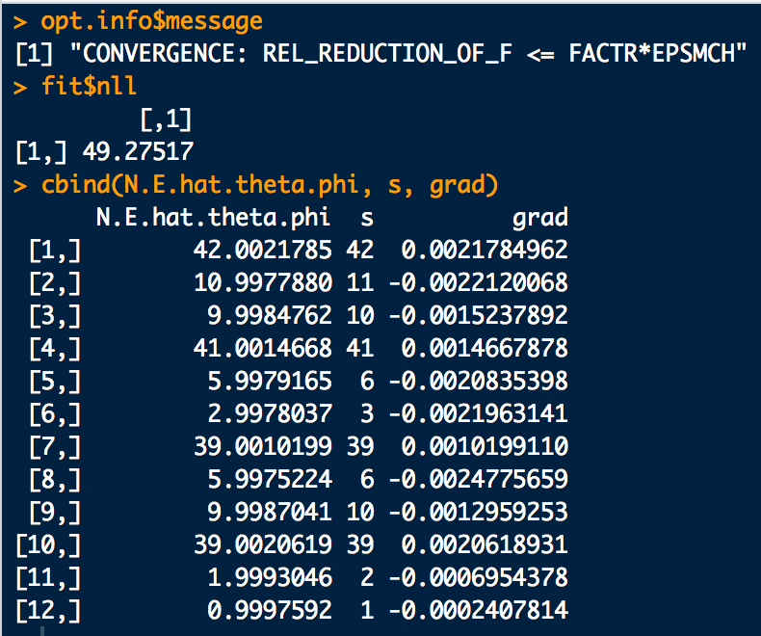

Slide 85
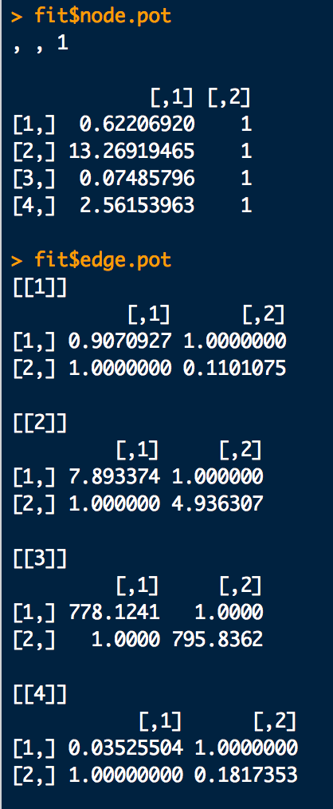
# Optimized potentials:
fit$node.pot
fit$edge.pot
# Optimized marginals:
lbp.margials.info <- infer.lbp(fit)
lbp.margials.info

Slide 86
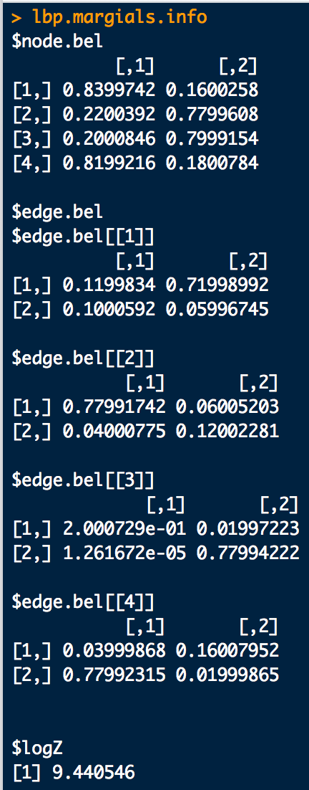
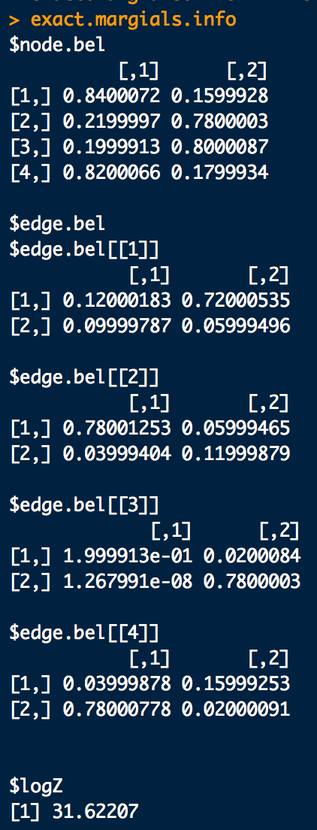
Model inferences from LBP
Exact model inferences for comparison

Slide 87
Maximum Pseudolikelihood
Approximation for MRF Parameters

Slide 88
(Log) Pseudo-Likelihood
In another approach to estimate the parameters, consider observing the state of all nodes in a configuration except for one, X_{i}.
The probability of X_{i} given the realized states of the other nodes is:
That is, this is the probability of X_{i} conditioned on the state of all the other nodes
Notes:
88

Slide 89
Within the MRF model this conditional is proportional to:
With:
we can express this conditional as:
The normalization constant for this conditional is not a nightmare to evaluate:
For Ising-like models, this is just two terms:
Notes:
89

Slide 90
The likelihood of the MRF for an observation of a particular configuration can be a approximated as a product of these conditional likelihoods:
Called a pseudo-likelihood for configuration X
Log pseudo-likelihood for a configuration:

Slide 91
The total likelihood for a sample of configurations (N of them) is then approximately:
Taking the log:

Slide 92
Note the correspondence:
feature formulation
feature function formulation
Note: When using the feature formulation: We can’t just use the feature vector for configuration X, . The component formulas for each φ_{l[i]} and φ_{l[ij]} must be used because the value of φ_{l} depends on the states of all nodes associated with θ_{l} in general.

Slide 93
Recall: Features
For node parameters τ:
A little extra notation to indicate node i is associated with parameter k. Though i and k are often the same number, they can differ depending on the parameterization scheme.
For edge parameters ω:
A little extra notation for edges to show what nodes are associated with parameter k

Slide 94
For the purposes of future expositions, let us again consider the “weirdly” parameterized triangle model on slide 44. Use the sample: X = {(1,1,1), (1,2,1), (2,2,1), (2,2,2)}
X₂
X₁
X₃

Slide 95
Recall: Parameter Index Matrices
node.par (η_{τ}) for the “weird” triangle model:
s_{Xi}= ⬆ ⬇
X₁
X₂
X₃
edge.par (ε_{ω}) for the “weird” triangle model:
X₂:
X₃:
X₃:
⬆ ⬇
⬆ ⬇
⬆ ⬇
X₁:
⬆
⬇
X₁:
⬆
⬇
X₂:
⬆
⬇

Slide 96
Let’s compute the conditional energies by hand using the feature formulation. This is tedious, but will make the need for the Note stipulated on slide 89 apparent. Use the formulas on slides 49-51 and 90 to help do these computations.
Taking a look at the sample, these are the θ components we’ll need:

Slide 101
Now let’s use the functionality of CRFutil to do the same calculations (with much less effort):
library(CRFutil)
# Graph formula:
grphf <- ~A:B:C
adj <- ug(grphf, result="matrix")
n.states <- 2
fitc <- make.crf(adj, n.states)
fitc <- make.features(fitc)
fitc <- make.par(fitc, 6)
# Parameterization:
fitc$node.par[1,1,] <- 1
fitc$node.par[2,1,] <- 2
fitc$node.par[3,1,] <- 2
fitc$edge.par[[1]][1,1,1] <- 3
fitc$edge.par[[1]][2,2,1] <- 3
fitc$edge.par[[2]][1,1,1] <- 2
fitc$edge.par[[2]][2,2,1] <- 4
fitc$edge.par[[3]][1,1,1] <- 5
fitc$edge.par[[3]][2,2,1] <- 6
s1<-1
s2<-2
f0 <- function(y){ as.numeric(c((y==1),(y==2)))} # Feature function

Slide 102
configs <- rbind(
c(1,1,1),
c(1,2,1),
c(2,2,1),
c(2,2,2)
)
# Make up a test parameter vector with theta_1 = 1, theta_2 = 2, etc:
theta <- c(1,2,3,4,5,6)
fitc$par <- theta
jk <- make.pots(parms=fitc$par, crf = fitc,
rescaleQ=F, replaceQ=T, format = "regular", printQ=T)
xn <- 4 # Configuration number
cn <- 3 # Conditional node number
# Feature formulation of conditional energy:
conditional.config.energy2(
config = configs[xn,],
condition.element.number = cn, crf=fitc, ff=f0, printQ=FALSE)
# Feature function formulation of conditional energy:
# (should give same as above)
conditional.config.energy(
config = configs[xn,],
condition.element.number = cn, crf=fitc, ff=f0, printQ=FALSE)

Slide 103
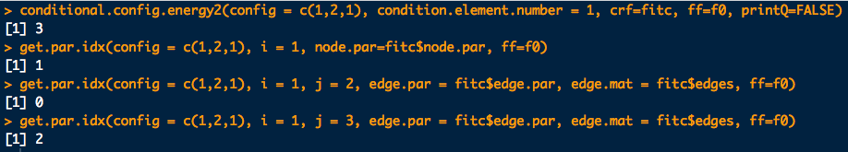
# Example calculation to compare with slide 92
# Examine each conditional energy component by hand:
# X = (1,2,1)
conditional.config.energy2(config = c(1,2,1), condition.element.number = 1, crf=fitc, ff=f0, printQ=FALSE)
get.par.idx(config = c(1,2,1), i = 1, node.par=fitc$node.par, ff=f0)
get.par.idx(config = c(1,2,1), i = 1, j = 2, edge.par = fitc$edge.par, edge.mat = fitc$edges, ff=f0)
get.par.idx(config = c(1,2,1), i = 1, j = 3, edge.par = fitc$edge.par, edge.mat = fitc$edges, ff=f0)
Based on our parameterization/parameter values,
these should sum to the first output.

Slide 104
# Examine each conditional energy component by hand:
# X = (1,1,1)
conditional.config.energy2(config = c(1,1,1), condition.element.number = 1, crf=fitc, ff=f0, printQ=FALSE)
get.par.idx(config = c(1,1,1), i = 1, node.par=fitc$node.par, ff=f0)
get.par.idx(config = c(1,1,1), i = 1, j = 2, edge.par = fitc$edge.par, edge.mat = fitc$edges, ff=f0)
get.par.idx(config = c(1,1,1), i = 1, j = 3, edge.par = fitc$edge.par, edge.mat = fitc$edges, ff=f0)
conditional.config.energy2(config = c(1,1,1), condition.element.number = 2, crf=fitc, ff=f0, printQ=FALSE)
get.par.idx(config = c(1,1,1), i = 2, node.par=fitc$node.par, ff=f0)
get.par.idx(config = c(1,1,1), i = 1, j = 2, edge.par = fitc$edge.par, edge.mat = fitc$edges, ff=f0)
get.par.idx(config = c(1,1,1), i = 2, j = 3, edge.par = fitc$edge.par, edge.mat = fitc$edges, ff=f0)
conditional.config.energy2(config = c(1,1,1), condition.element.number = 3, crf=fitc, ff=f0, printQ=FALSE)
get.par.idx(config = c(1,1,1), i = 3, node.par=fitc$node.par, ff=f0)
get.par.idx(config = c(1,1,1), i = 1, j = 3, edge.par = fitc$edge.par, edge.mat = fitc$edges, ff=f0)
get.par.idx(config = c(1,1,1), i = 2, j = 3, edge.par = fitc$edge.par, edge.mat = fitc$edges, ff=f0)
# X = (1,2,1)
conditional.config.energy2(config = c(1,2,1), condition.element.number = 1, crf=fitc, ff=f0, printQ=FALSE)
get.par.idx(config = c(1,2,1), i = 1, node.par=fitc$node.par, ff=f0)
get.par.idx(config = c(1,2,1), i = 1, j = 2, edge.par = fitc$edge.par, edge.mat = fitc$edges, ff=f0)
get.par.idx(config = c(1,2,1), i = 1, j = 3, edge.par = fitc$edge.par, edge.mat = fitc$edges, ff=f0)
conditional.config.energy2(config = c(1,2,1), condition.element.number = 2, crf=fitc, ff=f0, printQ=FALSE)
get.par.idx(config = c(1,2,1), i = 2, node.par=fitc$node.par, ff=f0)
get.par.idx(config = c(1,2,1), i = 1, j = 2, edge.par = fitc$edge.par, edge.mat = fitc$edges, ff=f0)
get.par.idx(config = c(1,2,1), i = 2, j = 3, edge.par = fitc$edge.par, edge.mat = fitc$edges, ff=f0)
conditional.config.energy2(config = c(1,2,1), condition.element.number = 3, crf=fitc, ff=f0, printQ=FALSE)
get.par.idx(config = c(1,2,1), i = 3, node.par=fitc$node.par, ff=f0)
get.par.idx(config = c(1,2,1), i = 1, j = 3, edge.par = fitc$edge.par, edge.mat = fitc$edges, ff=f0)
get.par.idx(config = c(1,2,1), i = 2, j = 3, edge.par = fitc$edge.par, edge.mat = fitc$edges, ff=f0)

Slide 105
# Examine each conditional energy component by hand:
# X = (2,2,1)
conditional.config.energy2(config = c(2,2,1), condition.element.number = 1, crf=fitc, ff=f0, printQ=FALSE)
get.par.idx(config = c(2,2,1), i = 1, node.par=fitc$node.par, ff=f0)
get.par.idx(config = c(2,2,1), i = 1, j = 2, edge.par = fitc$edge.par, edge.mat = fitc$edges, ff=f0)
get.par.idx(config = c(2,2,1), i = 1, j = 3, edge.par = fitc$edge.par, edge.mat = fitc$edges, ff=f0)
conditional.config.energy2(config = c(2,2,1), condition.element.number = 2, crf=fitc, ff=f0, printQ=FALSE)
get.par.idx(config = c(2,2,1), i = 2, node.par=fitc$node.par, ff=f0)
get.par.idx(config = c(2,2,1), i = 1, j = 2, edge.par = fitc$edge.par, edge.mat = fitc$edges, ff=f0)
get.par.idx(config = c(2,2,1), i = 2, j = 3, edge.par = fitc$edge.par, edge.mat = fitc$edges, ff=f0)
conditional.config.energy2(config = c(2,2,1), condition.element.number = 3, crf=fitc, ff=f0, printQ=FALSE)
get.par.idx(config = c(2,2,1), i = 3, node.par=fitc$node.par, ff=f0)
get.par.idx(config = c(2,2,1), i = 1, j = 3, edge.par = fitc$edge.par, edge.mat = fitc$edges, ff=f0)
get.par.idx(config = c(2,2,1), i = 2, j = 3, edge.par = fitc$edge.par, edge.mat = fitc$edges, ff=f0)
# X = (2,2,2)
conditional.config.energy2(config = c(2,2,2), condition.element.number = 1, crf=fitc, ff=f0, printQ=FALSE)
get.par.idx(config = c(2,2,2), i = 1, node.par=fitc$node.par, ff=f0)
get.par.idx(config = c(2,2,2), i = 1, j = 2, edge.par = fitc$edge.par, edge.mat = fitc$edges, ff=f0)
get.par.idx(config = c(2,2,2), i = 1, j = 3, edge.par = fitc$edge.par, edge.mat = fitc$edges, ff=f0)
conditional.config.energy2(config = c(2,2,2), condition.element.number = 2, crf=fitc, ff=f0, printQ=FALSE)
get.par.idx(config = c(2,2,2), i = 2, node.par=fitc$node.par, ff=f0)
get.par.idx(config = c(2,2,2), i = 1, j = 2, edge.par = fitc$edge.par, edge.mat = fitc$edges, ff=f0)
get.par.idx(config = c(2,2,2), i = 2, j = 3, edge.par = fitc$edge.par, edge.mat = fitc$edges, ff=f0)
conditional.config.energy2(config = c(2,2,2), condition.element.number = 3, crf=fitc, ff=f0, printQ=FALSE)
get.par.idx(config = c(2,2,2), i = 3, node.par=fitc$node.par, ff=f0)
get.par.idx(config = c(2,2,2), i = 1, j = 3, edge.par = fitc$edge.par, edge.mat = fitc$edges, ff=f0)
get.par.idx(config = c(2,2,2), i = 2, j = 3, edge.par = fitc$edge.par, edge.mat = fitc$edges, ff=f0)

Slide 106
Another Example: For a sample of size 100, show the two conditional energy formulations yield the same values on the Star network:
library(CRFutil)
# Graph formula for Star field:
grphf <- ~A:B+A:C+A:D+A:E+B:C+B:D+B:E+C:D+D:E
gp <- ug(grphf, result = "graph")
adj <- ug(grphf, result="matrix")
# Make up random potentials and return a CRF-object
num.samps <- 100
n.states <- 2
star <- sim.field.random(adjacentcy.matrix=adj, num.states=n.states,
num.sims=num.samps, seed=1)
samps <- star$samples
known.model <- star$model
mrf.sample.plot(samps)
# Needed for the energy functions:
pot.info <- make.gRbase.potentials(known.model, node.names = gp@nodes)
s1<-1
s2<-2
f0 <- function(y){ as.numeric(c((y==1),(y==2)))} # Feature function

Slide 107
Try out on all the sampled configurations:
# For storage:
en.result <- array(0, c(num.samps*ncol(samps),5))
# Loop around the sample numbers and then the elements of each sample
count <- 1
for(i in 1:num.samps) {
for(j in 1:ncol(samps)) {
samp.num <- i
elem.num <- j
ce1 <- conditional.config.energy( # Feature formulation
config = samps[samp.num,],
condition.element.number = elem.num,
crf=known.model,
ff=f0, printQ=FALSE)
ce2 <- conditional.config.energy2( # Feature function formulation
config = samps[samp.num,],
condition.element.number = elem.num,
crf=known.model,
ff=f0, printQ=FALSE)
en.result[count,] <- c(i,j,ce1,ce2,ce1-ce2)
count <- count + 1
}
}
en.result
en.result[,5]
plot(1:length(en.result[,5]),en.result[,5], ylab="Difference", xlab="Config index")

Slide 108
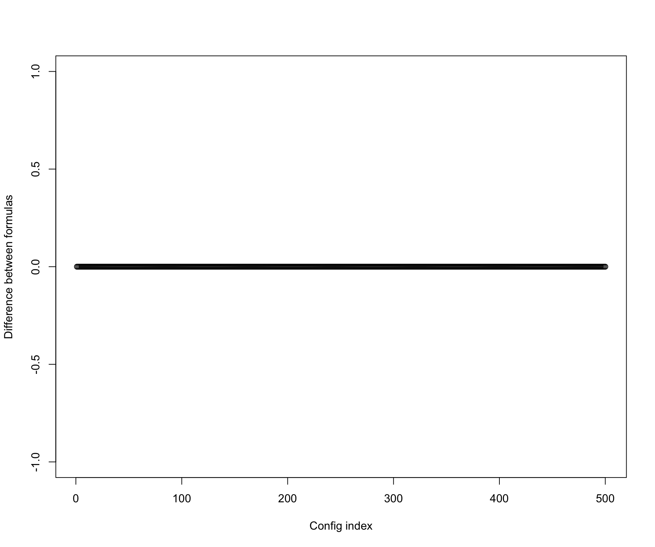
Check:
??
Yup!

Slide 109
We have enough tools now to see a concrete example of how the (log) likelihood differs from the (log) pseudo-likelihood.
The next example is a bit lengthy and in symbolic form, but the differences will be very clear.
X₂
Consider the MRF:
X₁
X₃

Slide 110
More specifically, with the parameterization:
X₂
X₁
X₃
compute pseudo-log likelihood vs. log likelihood for all possible configurations.

Slide 111
For the log pseudo-likelihood we’ll need:
This form will make the hand calculation of the pseudo-likelihood a little easier and more transparent

Slide 112
 | X
config # | X₁ | X₂ | X₃
1 | 1 | 1 | 1
2 | 2 | 1 | 1
3 | 1 | 2 | 1
4 | 2 | 2 | 1
5 | 1 | 1 | 2
6 | 2 | 1 | 2
7 | 1 | 2 | 2
8 | 2 | 2 | 2
All possible configurations are:
Using the conditional energy formula:
with the node parameter association that can be read off the graph on the previous slide:
node X_{i} | ne(i): connected nodes ( X_{i} ~ X_{j}) | associated parameters θ_{k}
1 | 2, 3 | 1, 4, 5, 6, 7
2 | 1, 3 | 2, 4, 5, 8, 9
3 | 1, 2 | 3, 6, 7, 8, 9

Slide 114
etc.

Slide 115
Synopsis:

Slide 116
Using the node complement equivalent configurations in the table below:
 | X |  |  | Complements (X_{i})
config # | X₁ | X₂ | X₃ | X₁' | X₂' | X₃'
1 | 1 | 1 | 1 | X₂ | X₃ | X₅
2 | 2 | 1 | 1 | X₁ | X₄ | X₆
3 | 1 | 2 | 1 | X₄ | X₁ | X₇
4 | 2 | 2 | 1 | X₃ | X₂ | X₈
5 | 1 | 1 | 2 | X₆ | X₇ | X₁
6 | 2 | 1 | 2 | X₅ | X₈ | X₂
7 | 1 | 2 | 2 | X₈ | X₅ | X₃
8 | 2 | 2 | 2 | X₇ | X₆ | X₄
we can write for example:

Slide 117
Synopsis:

Slide 121
For the log likelihood we’ll need:
This form will make the hand calculation a of the likelihood little easier and more transparent

Slide 122
With:

Slide 126
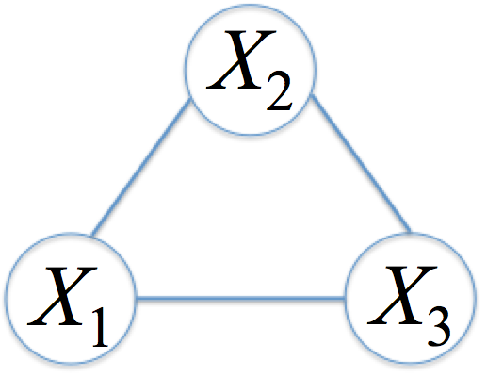
Finally, the totals are:
“Energy” for log pseudo-likelihood
“Normalizer” for log pseudo-likelihood
“Energy” for log likelihood
“Normalizer” for log likelihood

Slide 127
Example: We can visualize the sample likelihood vs. pseudo-likelihood for a model with only two parameters. Consider:
A
B
From a sample of size 25 and known values for (see R code of next slide):
Compute the -log pseudo-likelihood and -log likelihood surfaces, and render them in 3D
Pinpoint the approximate minimum of both surfaces and compare to the true values

Slide 128
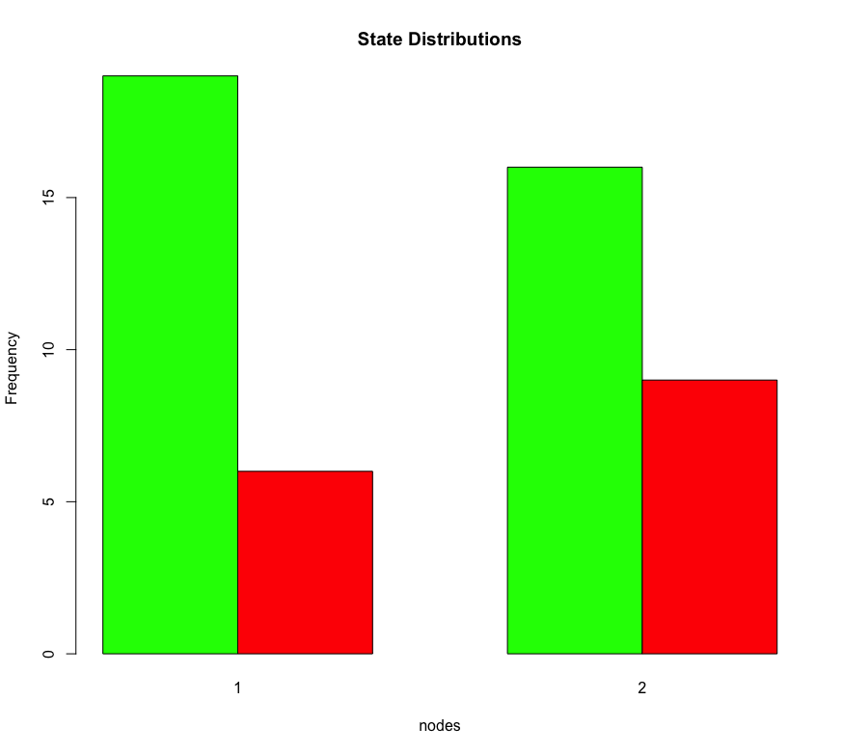
Let’s assign the “true” to be:
For reproducibility, lets get a sample of configurations with seed = 1.
library(CRFutil)
grphf <- ~A:B
adj <- ug(grphf, result="matrix")
f0 <- function(y){ as.numeric(c((y==1),(y==2)))}
n.states <- 2
known.model <- make.crf(adj, n.states)
# First lets get a sample of configurations from a "true" model:
# The "true" theta is: (1.098612, -0.7096765) which translates to the potentials below.
# True node pots:
PsiA <- c(3,1)
PsiB <- c(3,1)
# True edge pots:
PsiAB <-
rbind(
c(3, 6.1),
c(6.1, 3)
)
known.model$node.pot[1,] <- PsiA
known.model$node.pot[2,] <- PsiB
known.model$edge.pot[[1]] <- PsiAB
# So now sample from the model as if we obtained an experimental sample:
num.samps <- 25
set.seed(1)
samps <- sample.exact(known.model, num.samps)
mrf.sample.plot(samps)

Slide 129
-log pseudo-likelihood and -log likelihood surface calculations
library(rgl)
# Check that we instantiated the theta we intended:
log(known.model$node.pot) # True theta1??
log(known.model$edge.pot[[1]]) - max(log(known.model$edge.pot[[1]])) # True theta2??
# Set up a grid of theta's over which to compute the sample log pseudolikelihood
# and likelihood:
theta1 <- seq(from = 0.0, to=2.5, by = 0.05)
theta2 <- seq(from = -2.0, to=1.0, by = 0.05)
theta.grid <- as.matrix(expand.grid(theta1,theta2))
dim(theta.grid)
# Compute the sample log pseudolikelihoods and likelihoods over the theta grid:
neg.log.psls <- array(NA, nrow(theta.grid))
neg.log.lik <- array(NA, nrow(theta.grid))
fit$par.stat <- mrf.stat(crf = fit, instances = samps) # Needed for log likelihood
for(i in 1:nrow(theta.grid)) {
print(i)
theta.i <- theta.grid[i,]
neg.log.psls[i] <- neglogpseudolik(par = theta.i, crf = fit, samples = samps,
conditional.energy.function.type = "feature",
ff = f0, update.crfQ = F)
neg.log.lik[i] <- negloglik(par = theta.i, crf = fit, samples = samps,
infer.method = infer.exact, update.crfQ = F)
}

Slide 130
Pinpoint the minima of -log pseudo-likelihood and -log likelihood surfaces:
# Locate the rough minima of the surfaces:
min.idx.plk <- which(neg.log.psls == min(neg.log.psls))
min.idx.lik <- which(neg.log.lik == min(neg.log.lik))
# Plot the sample pseudo-likelihood over the theta grid and the rough minimum:
open3d()
plot3d(theta.grid[,1], theta.grid[,2], neg.log.psls, xlab="theta1", ylab="theta2", zlab="",
main="log pseudo-lik")
text3d(theta.grid[min.idx.plk,1], theta.grid[min.idx.plk,2], neg.log.psls[min.idx.plk],
texts = "min")
lines3d(c(theta.grid[min.idx.plk,1],theta.grid[min.idx.plk,1]),
c(theta.grid[min.idx.plk,2],theta.grid[min.idx.plk,2]),
c(neg.log.psls[min.idx.plk], max(neg.log.psls)))
text3d(theta.grid[min.idx.plk,1], theta.grid[min.idx.plk,2], max(neg.log.psls),
texts = "min")
# Plot the sample likelihood over the theta grid and the rough minimum:
open3d()
plot3d(theta.grid[,1], theta.grid[,2], neg.log.lik, xlab="theta1", ylab="theta2", zlab="", main="negloglik")
text3d(theta.grid[min.idx.lik,1], theta.grid[min.idx.lik,2], neg.log.lik[min.idx.lik],
texts = "min")
lines3d(c(theta.grid[min.idx.lik,1],theta.grid[min.idx.lik,1]),
c(theta.grid[min.idx.lik,2],theta.grid[min.idx.lik,2]),
c(neg.log.lik[min.idx.lik], max(neg.log.lik)))
text3d(theta.grid[min.idx.lik,1], theta.grid[min.idx.lik,2], max(neg.log.lik),
texts = "min")

Slide 131
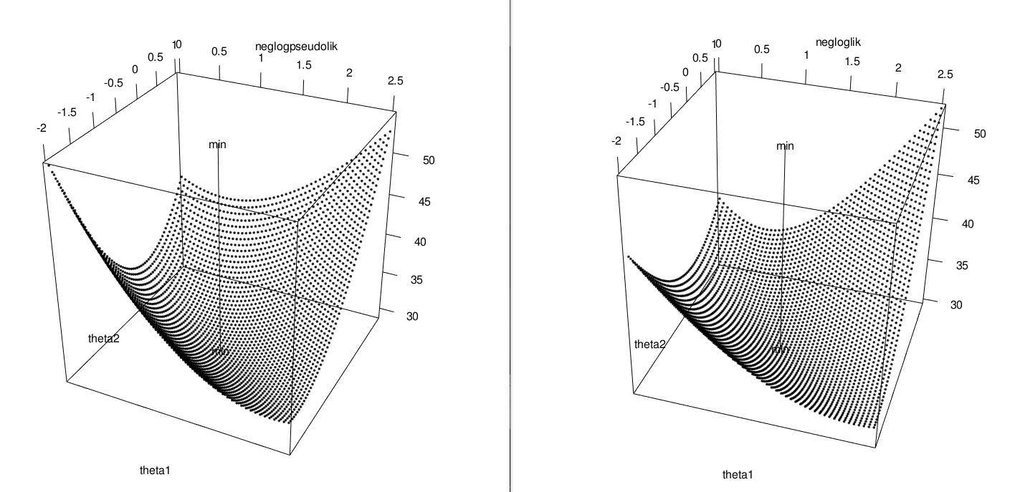
Negative log pseudo-likelihood
Negative log likelihood
Rough minimum turned out to occur in the same spot:
Note, the true parameter vector is:

Slide 132
Gradient of the Log Pseudo-Likelihood
Now let’s work on the gradient of the log pseudo-likelihood.
It’s really advantageous to have this when we optimize the parameters with it
I.E. Given a sample and considering the (pseudo-likelihood) approximation:
Determine:

Slide 133
A little extra notation to indicate the survivors are all associated with node i.
The number of times θ_{k} appears in the expression for E(X_{i}|X/X_{i}). If there are no parameters shared between nodes and edges and edges and edges then these will be 1 or 0, i.e.
Next slide

Slide 134
A little extra notation to indicate that the configuration X within the sum depends on the state of X_{i}.
for Ising-like models

Slide 135
So:
for Ising-like models
Indicates average over states of X_{i}
The average number of times parameter θ_{k} appears in conditional energies E(X_{i}|X/X_{i})

Slide 136
Putting all the terms for the derivative of the pseudo-likelihood together:
If parameter k is not associated with node i then:

Slide 137
What do each of these pieces for the gradient of the pseudo-likelihood of an Ising-like model look like??
It’s also handy in that the conditional energy gradients have a nice (pedagogical) matrix representation in this notation:
is a vector of length w (the number of params).
Remember: A little extra notation to indicate the terms that “survive” are associated with node i.
There are N (the number of nodes) of these vectors.
Stacking the N gradients column (or row)-wise gives the conditional energy “gradient matrix” representation with elements:
Remember:

Slide 138
Example
Consider the graph with (admittedly really weird) parameterization:
NOTE: There are shared parameters in this model, so
in general.
X₂
X₁
X₄
X₃

Slide 139
Example
Compute the conditional energy gradient matrix for X₁ = (1,1,1,1):
First note:
a. For k = 1, i = 1
ETC…
b. For k = 2, i = 1

Slide 140
Example
So:
Thus:

Slide 141
Example
Check:
library(CRFutil)
# Graph formula for example model:
grphf <- ~1:2+1:3+1:4
gp <- ug(grphf, result = "graph")
adj <- ug(grphf, result="matrix")
# Define states and feature function:
s1 <- 1
s2 <- 2
f0 <- function(y){ as.numeric(c((y==s1),(y==s2))) }
n.states <- 2
fitc <- make.crf(adj, n.states)
fitc <- make.features(fitc)
fitc <- make.par(fitc, 6)
# Parameterization:
fitc$node.par[1,1,] <- 1
fitc$node.par[2,1,] <- 2
fitc$node.par[3,1,] <- 1
fitc$node.par[4,1,] <- 3
fitc$edge.par[[1]][1,1,1] <- 1
fitc$edge.par[[1]][2,2,1] <- 4
fitc$edge.par[[2]][1,1,1] <- 1
fitc$edge.par[[2]][2,2,1] <- 5
fitc$edge.par[[3]][1,1,1] <- 6
fitc$edge.par[[3]][2,2,1] <- 1

Slide 142
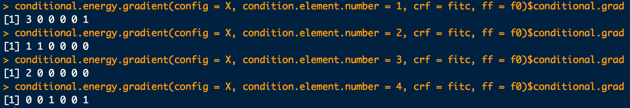
Example
Check:
X <- c(1,1,1,1)
conditional.energy.gradient(config = X, condition.element.number = 1, crf = fitc, ff = f0)$conditional.grad
conditional.energy.gradient(config = X, condition.element.number = 2, crf = fitc, ff = f0)$conditional.grad
conditional.energy.gradient(config = X, condition.element.number = 3, crf = fitc, ff = f0)$conditional.grad
conditional.energy.gradient(config = X, condition.element.number = 4, crf = fitc, ff = f0)$conditional.grad

Slide 143
Another Example
Try X₁, X₃, k = 7 (i.e. θ₇) with the Star field model with all parameters different between nodes and edges:
a. Show:
b. Evaluate:
c. Evaluate:

Slide 144
Another Example
Reminder on the Star field and the parameterization we will use for this example:
2
1
4
5
3

Slide 145
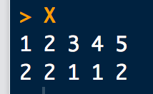
The Star field model with all parameters different between nodes and edges. Using a random parameter vector, get a sample of configurations and grab the first to be X₁:
library(CRFutil)
# Star field model:
grphf <- ~1:2+1:3+1:4+1:5+2:3+2:4+2:5+3:4+3:5
adj <- ug(grphf, result="matrix")
# Make up random potentials and return a CRF-object
star <- sim.field.random(adjacentcy.matrix=adj, num.states=2, num.sims=1, seed=1)
samps <- star$samples
known.model <- star$model
# Feature function
f0 <- function(y){ as.numeric(c((y==1),(y==2)))}
# Grab the first sampled configuration:
X <- samps[1,]
X
X₁:

Slide 146
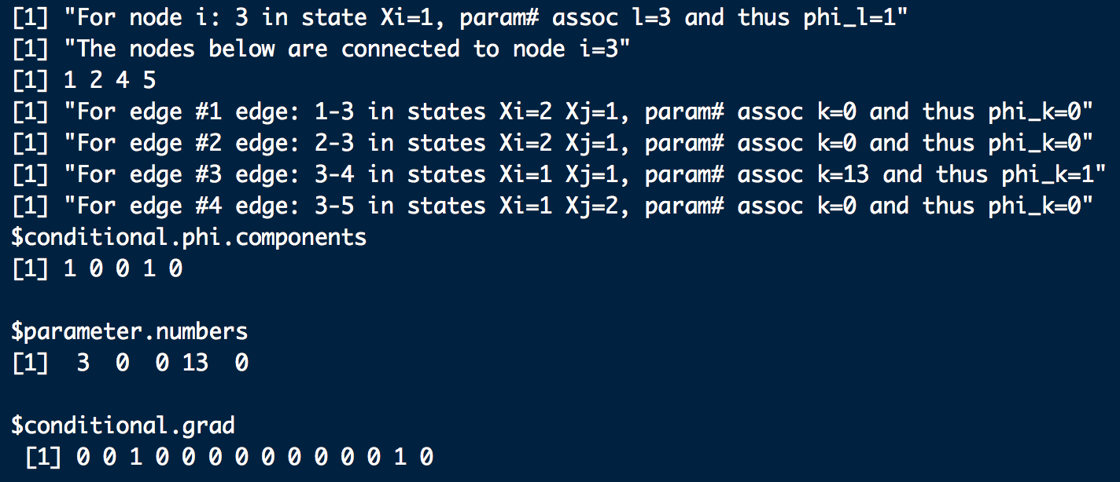
a. Show:
#a. Gradient of E(X3|X/X3)
dE.X3.Xb <- conditional.energy.gradient(config = X, condition.element.number = 3,
crf = known.model, ff = f0, printQ=F)
dE.X3.Xb
dE.X3.Xb <- dE.X3.Xb$conditional.grad
# dE/dth7:
dE.X3.Xb[7]
X₁: (2,2,1,1,0)

Slide 147

b. Evaluate:
#b. Requisite energies, potentials and gradients
E.X3.Xb <- conditional.config.energy2(theta.par = NULL, config = X,
condition.element.number = 3,
crf = known.model, ff = f0)
P.X3.Xb <- exp(E.X3.Xb) # potential needed
dE.X3.Xb <- conditional.energy.gradient(config = X,
condition.element.number = 3,
crf = known.model, ff = f0, printQ=F)
dE.X3.Xb <- dE.X3.Xb$conditional.grad # derivative needed
# Complement energies, potentials and gradients
Xc <- complement.at.idx(configuration = X, complement.index = 3)
E.X3.Xbc <- conditional.config.energy2(theta.par = NULL, config = Xc,
condition.element.number = 3,
crf = known.model, ff = f0)
P.X3.Xbc <- exp(E.X3.Xbc) # complement potential needed
dE.X3.Xbc <- conditional.energy.gradient(config = Xc, condition.element.number = 3,
crf = known.model, ff = f0, printQ=F)
dE.X3.Xbc <- dE.X3.Xbc$conditional.grad # complement derivative needed
# Assemble \frac{\partial}{\partial \theta_7} Z_{X_3|{\bf X}_1\slash X_3}
dZ.X3.Xb.th7 <- P.X3.Xb * dE.X3.Xb[7] + P.X3.Xbc * dE.X3.Xbc[7]
dZ.X3.Xb.th7

Slide 148

c. Evaluate:
# c. First compute the required Z(X3|X/X3)
logZ.X3.Xb <- logsumexp2(c(E.X3.Xb, E.X3.Xbc))
Z.X3.Xb <- exp(logZ.X3.Xb)
# Compute the required probabilities
Pr.X3.Xb <- P.X3.Xb/Z.X3.Xb
Pr.X3.Xbc <- P.X3.Xbc/Z.X3.Xb
# Assemble \frac{\partial}{\partial \theta_7}\log\Big( Z_{X_3|{\bf X}_1\slash X_3} \Big)
Pr.X3.Xb * dE.X3.Xb[7] + Pr.X3.Xbc * dE.X3.Xbc[7]
# Or we can do this:
1/Z.X3.Xb * dZ.X3.Xb.th7

Slide 149
Review: What we learned about the gradient of the
log pseudolikelihood for a configuration
So going back to the (log) pseudo-likelihood of a configuration and its gradient:

Slide 150
Looking at the formula for a component of the gradient:
we can compute the gradient by forming these two matrices (maybe column by column), subtracting them and finally summing across the columns of the resulting difference. This formula leaves a lot of room for parallelization.
# Gradient of the negative log pseudolikelihood for a configuration:
gnlpl.info <-grad.neglogpseudolik.config(
param = NULL,
config = X,
crf = known.model,
cond.en.form = "feature",
ff = f0)
gnlpl.info$grad.neglogpseudolik
gnlpl.info$alpha
-gnlpl.info$alpha[7,3]
gnlpl.info$dZ
-gnlpl.info$dZ[7,3]
gnlpl.info$Ealpha
-gnlpl.info$Ealpha[7,3]
Should be answers to a, b and c from previous example

Slide 151
Thus, for a sample of N configurations X the pseudo-likelihood and its’ gradient are :

Slide 152
Sample pseudo-likelihood:
Gradient of sample pseudo-likelihood:

Slide 153
Example: Let’s go back to the two parameter problem we could visualize:
A
B
Using the same sample of 25 that we used for the previous two parameter example:
a. Compute the gradient of sample pseudo-likelihood and plot it in 2D
b. Pin-point a better approximate minimum of the pseudo-likelihood
surface.
c. Compute the potentials from the optimal parameter vector and compare
to those used to generate the original sample.

Slide 154
library(CRFutil)
grphf <- ~A:B
adj <- ug(grphf, result="matrix")
f0 <- function(y){ as.numeric(c((y==1),(y==2)))}
n.states <- 2
known.model <- make.crf(adj, n.states)
# First lets get a sample of configurations from a "true" model:
# The "true" theta is: (1.098612, -0.7096765) which translates to the potentials
# below.
# True node pots:
PsiA <- c(3,1)
PsiB <- c(3,1)
# True edge pots:
PsiAB <-
rbind(
c(3, 6.1),
c(6.1, 3)
)
known.model$node.pot[1,] <- PsiA
known.model$node.pot[2,] <- PsiB
known.model$edge.pot[[1]] <- PsiAB
# So now sample from the model as if we obtained an experimental sample:
num.samps <- 25
set.seed(1)
samps <- sample.exact(known.model, num.samps)
mrf.sample.plot(samps)

Slide 155
a.
# Instantiate an empty two node two parameter model to work with:
fit <- make.crf(adj, n.states)
fit <- make.features(fit)
fit <- make.par(fit, 2)
fit$node.par[1,1,] <- 1
fit$node.par[2,1,] <- 1
fit$edge.par[[1]][1,1,1] <- 2
fit$edge.par[[1]][2,2,1] <- 2
# Set up a grid of thetas:
theta1 <- seq(from = 0.0, to=2.5, by = 0.05)
theta2 <- seq(from = -2.0, to=1.0, by = 0.05)
# Sample neg log pseudo-likelihood and neg log likelihood and their gradients:
# Containers for the negative log pseudolikelihood
npll.mat <- array(NA, c(length(theta1), length(theta2)))
grad.npll.mat.u <- array(NA, c(length(theta1), length(theta2)))
grad.npll.mat.v <- array(NA, c(length(theta1), length(theta2)))
# Containers for the negative log pseudolikelihood
nll.mat <- array(NA, c(length(theta1), length(theta2)))
grad.nll.mat.u <- array(NA, c(length(theta1), length(theta2)))
grad.nll.mat.v <- array(NA, c(length(theta1), length(theta2)))

Slide 156
a.
count <- 1
for(i in 1:length(theta1)) {
for(j in 1:length(theta2)) {
print(count)
theta <- c(theta1[i], theta2[j])
# Negative log pseudo likelihood and gradient:
npll.info <- neglogpseudolik(par = theta, crf = fit, samples = samps,
conditional.energy.function.type = "feature",
ff = f0, gradQ = T, update.crfQ = F)
npll.mat[i,j] <- npll.info$samp.neglogpseudolik
neg.log.psl.grad <- npll.info$samp.grad.neglogpseudolik
grad.npll.mat.u[i,j] <- neg.log.psl.grad[1]
grad.npll.mat.v[i,j] <- neg.log.psl.grad[2]
# Negative log likelihood and gradient:
# update.crf=T must be true to use the current theta. NOTE: par in fit will ne changing!
nll.mat[i,j] <- negloglik(par = theta, crf = fit, samples = samps,
infer.method = infer.exact, update.crfQ = T)
grad.nll.mat.u[i,j] <- fit$gradient[1]
grad.nll.mat.v[i,j] <- fit$gradient[2]
count <- count + 1
}
}

Slide 157
a.
# Library to help plot vector fields
library(OceanView)
# Make a 2D plot of the gradient for the negative log pseudo likelihood:
u <- grad.npll.mat.u
v <- grad.npll.mat.v
# Sample negative log pseudo-likelihood:
image2D(x = theta1, y = theta2, z = npll.mat, contour = TRUE, xlab="theta1", ylab="theta2")
# Gradient negative log pseudo-likelihood:
quiver2D(x = theta1, y = theta2, u = u, v = v, add = TRUE, by = 6)
#-------
# Make a 2D plot of the gradient for the negative log likelihood:
ul <- grad.nll.mat.u
vl <- grad.nll.mat.v
# Sample negative log likelihood:
image2D(x = theta1, y = theta2, z = nll.mat, contour = TRUE, xlab="theta1", ylab="theta2")
# Gradient negative log likelihood:
quiver2D(x = theta1, y = theta2, u = ul, v = vl, add = TRUE, by = 6)

Slide 158
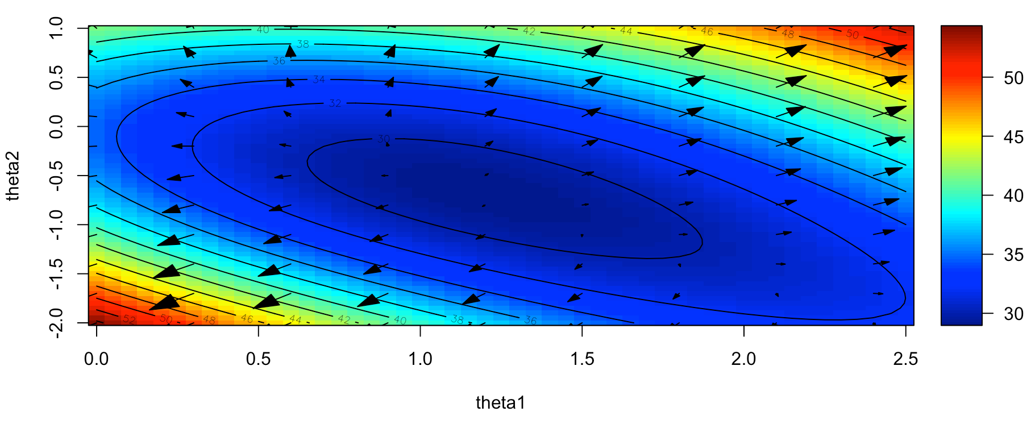
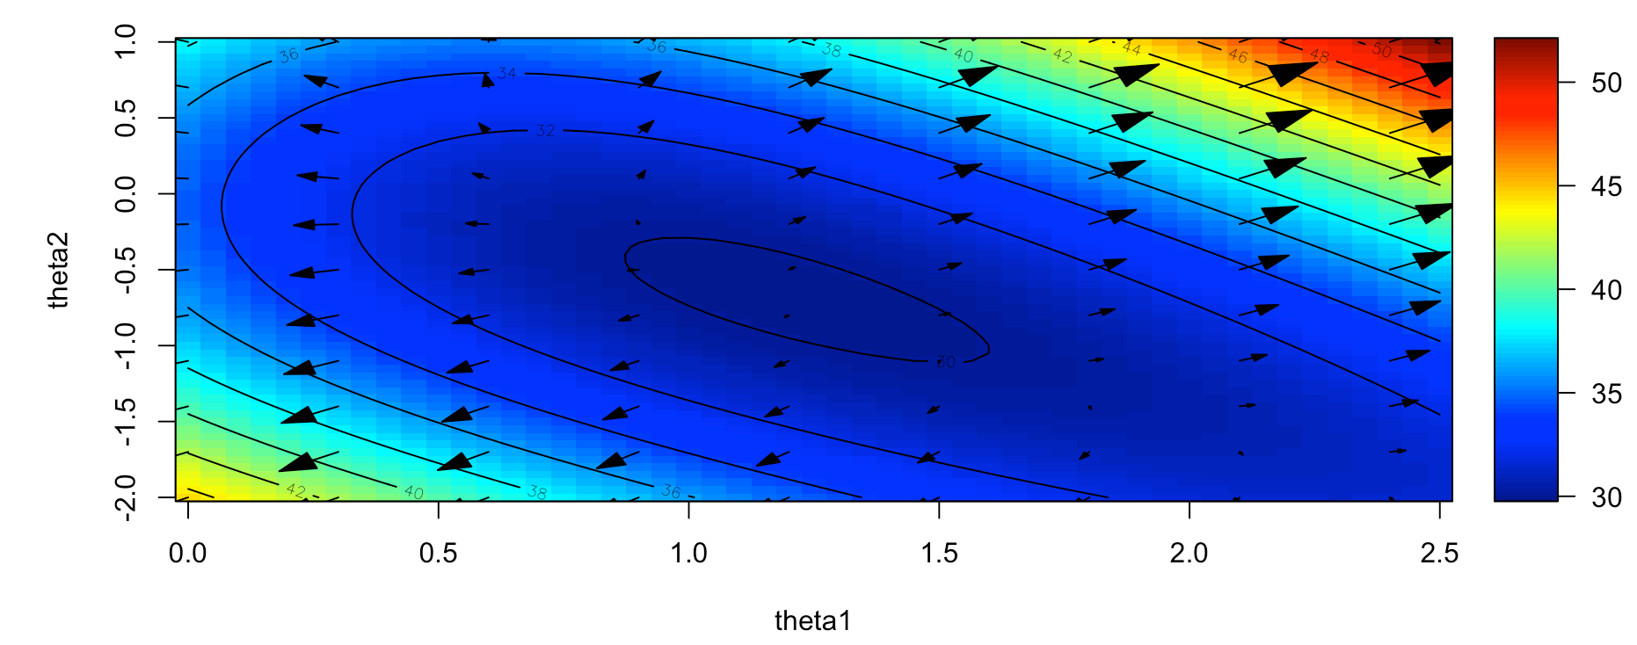
Negative log pseudo likelihood and its gradient:
a.
Negative log likelihood and its gradient:

Slide 159

b.
# Optimize theta: find minimum of negative log pseudo-likelihood:
# Auxiliary, gradient convenience function. Follows train.mrf in CRF:
gradient <- function(par, crf, ...) { crf$gradient }
fit$par <- c(0,0) # Reset theta to start at 0
opt.info <- stats::optim( # optimize parameters
par = fit$par, # theta
fn = neglogpseudolik2, # objective function
gr = gradient, # grad of obj func
crf = fit, # passed to fn/gr
samples = samps, # passed to fn/gr
conditional.energy.function.type = "feature", # passed to fn/gr
ff = f0, # passed to fn/gr
gradQ = TRUE, # passed to fn/gr
update.crfQ = TRUE, # passed to fn/gr
method = "L-BFGS-B",
control = list(trace = 1, REPORT=1))
opt.info$convergence
opt.info$message
fit$gradient
fit$nll
fit$par

Slide 160
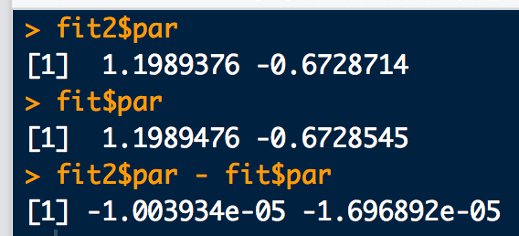
# Instantiate a new CRF object to do the negative log likelihood minimization:
fit2 <- make.crf(adj, n.states)
fit2 <- make.features(fit2)
fit2 <- make.par(fit2, 2)
fit2$node.par[1,1,] <- 1
fit2$node.par[2,1,] <- 1
fit2$edge.par[[1]][1,1,1] <- 2
fit2$edge.par[[1]][2,2,1] <- 2
fit2$par.stat <- mrf.stat(crf = fit2, instances = samps)
fit2$par <- c(0,0)
opt.info <- stats::optim( # optimize parameters
par = fit2$par, # theta
fn = negloglik, # objective function
gr = gradient, # grad of obj func
crf = fit2, # passed to fn/gr
samples = samps, # passed to fn/gr
update.crfQ = TRUE, # passed to fn/gr
method = "L-BFGS-B",
control = list(trace = 1, REPORT=1))
opt.info$convergence
opt.info$message
fit2$gradient
fit2$nll
fit2$par
fit$par
fit2$par - fit$par
b.

Slide 161
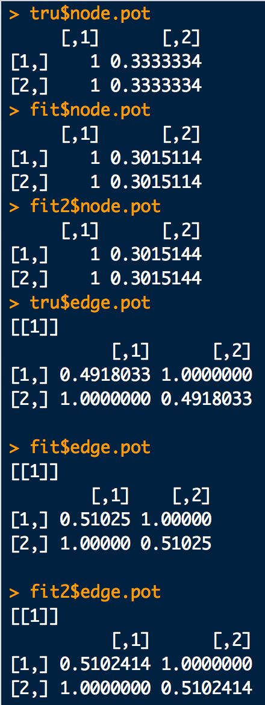
c.
# Instantiate the true model with the actual theta:
tru <- make.crf(adj, n.states)
tru <- make.features(tru)
tru <- make.par(tru, 2)
tru$node.par[1,1,] <- 1
tru$node.par[2,1,] <- 1
tru$edge.par[[1]][1,1,1] <- 2
tru$edge.par[[1]][2,2,1] <- 2
tru$par <- c(1.098612, -0.7096765)
# Re-scale potentials to ensure they are in "standard form":
out.pot <- make.pots(parms = tru$par, crf = tru, rescaleQ = T, replaceQ = T)
out.pot <- make.pots(parms = fit$par, crf = fit, rescaleQ = T, replaceQ = T)
out.pot <- make.pots(parms = fit2$par, crf = fit2, rescaleQ = T, replaceQ = T)
tru$node.pot
fit$node.pot
fit2$node.pot
tru$edge.pot
fit$edge.pot
fit2$edge.pot
In these simple models, the parameter estimates both came out pretty close to each other, and pretty close to the true values.

Slide 162
Multilevel Logistic Regression
to Determine MRF Parameters

Slide 163
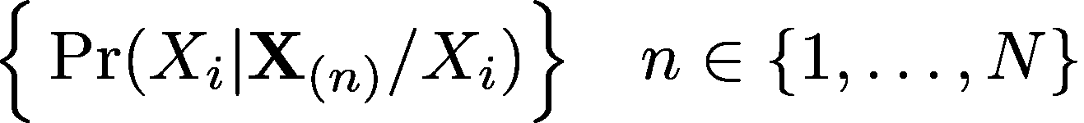
MRF relationship to Logistic Regression
Consider the set of all conditional probabilities that can be formed from all sampled configurations X_{(n)}:
As we have already seen, all of the MRF parameters are contained within the expressions of these conditional probabilities.
We can use this fact to build a set of simultaneous equations which we can “solve” for the unknown MRF parameters.
  The equations will have the form of a logistic regression, which we will now show.

Slide 164
Remembering that: Pr(X_{i}=1|X/X_{i}=1) + Pr(X_{i}=2|X/X_{i}=2) = 1, consider:
Taking logs:
i.e.:
Also note for good measure:

Slide 165
Recall: , among other things, is the number of times θ_{k} appears in the expression for E(X_{i}|X/X_{i}).
  is the vector of all p
  Note is the same length as the vector of parameters,
Using this notation we can denote the conditional node energy as:
So we can denote the difference of conditional node energies as:
Delta-alpha matrix

Slide 166
Each of the ΔE(i) are logits (log odds) of the conditional node probabilities.
Each node for each sample configuration contributes one of these logits:
node i
sample configuration n
Each of these logits can be collected into matrix-vector form:
with elements:
vector of p parameters
vector of logits, of length M (# nodes) × p (# parameters)
N (# samples) × p (# parameters) matrix of α differences

Slide 167
Assume:
then:
Thus, from this point of view, the determination of parameters can be seen as a multilevel logistic regression where the state of each node is regressed on the the states of the remaining nodes, across all sample configurations.

Slide 168
Consider the complete configuration space for the triangle model:
 | X |  |  | Complements (X_{i})
config # | X₁ | X₂ | X₃ | X₁' | X₂' | X₃'
1 | 1 | 1 | 1 | X₂ | X₃ | X₅
2 | 2 | 1 | 1 | X₁ | X₄ | X₆
3 | 1 | 2 | 1 | X₄ | X₁ | X₇
4 | 2 | 2 | 1 | X₃ | X₂ | X₈
5 | 1 | 1 | 2 | X₆ | X₇ | X₁
6 | 2 | 1 | 2 | X₅ | X₈ | X₂
7 | 1 | 2 | 2 | X₈ | X₅ | X₃
8 | 2 | 2 | 2 | X₇ | X₆ | X₄
Let’s symbolically compute the matrices: and
The result will allow us to see concretely, the logistic regression equations for all possible configurations that could be sampled.

Slide 169
Choosing (standard) parameterization the triangle model:
X₂
X₁
X₃

Slide 174
Collecting the logit calculations into matrix-vector form:
This is the set of all possible equations that would be involved in a logistic regression to determine the parameter vector

Slide 175
To see how we could do a logistic regression to determine the parameter vector:
Set up this triangle model with a known parameter vector.
Sample the model and collect 25 sample configurations.
Using the sampled configurations, determine the delta-alpha matrix
Use in a logistic regression on the individual sampled node states to estimate a parameter vector.
Using the estimated parameter vector determine the configuration probabilities, node belief and edge beliefs. Compare to their true values determined from the known parameter vector.

Slide 176
a.
library(CRFutil)
# Triangle model
grphf <- ~1:2+1:3+2:3
adj <- ug(grphf, result="matrix")
gp <- ug(grphf, result = "graph")
dev.off()
iplot(gp)
f0 <- function(y){ as.numeric(c((y==1),(y==2)))}
n.states <- 2
# Instantiate model and pick a "true" theta:
knm <- make.crf(adj, n.states)
knm <- make.features(knm)
knm <- make.par(knm, 6)
knm$node.par[1,1,] <- 1
knm$node.par[2,1,] <- 2
knm$node.par[3,1,] <- 3
knm$edge.par[[1]][1,1,1] <- 4
knm$edge.par[[1]][2,2,1] <- 4
knm$edge.par[[2]][1,1,1] <- 5
knm$edge.par[[2]][2,2,1] <- 5
knm$edge.par[[3]][1,1,1] <- 6
knm$edge.par[[3]][2,2,1] <- 6
set.seed(6)
knm$par <- runif(6,-1.5,1.1)
knm$par
# "true" theta:
#0.07629757 0.93786913 -0.81268462 -0.51175581 0.59945681 1.04299689
out.pot <- make.pots(parms = knm$par, crf = knm, rescaleQ = T, replaceQ = T)

Slide 177
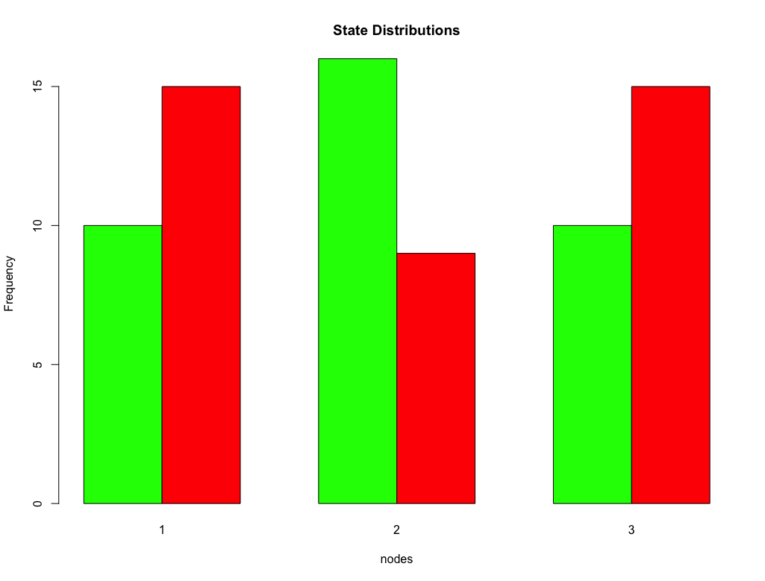
b, c.
# So now sample from the model as if we obtained an experimental sample:
num.samps <- 25
set.seed(1)
samps <- sample.exact(knm, num.samps)
mrf.sample.plot(samps)
# Instantiate an empty model to do the
# logistic fit on:
psl <- make.crf(adj, n.states)
psl <- make.features(psl)
psl <- make.par(psl, 6)
psl$node.par[1,1,] <- 1
psl$node.par[2,1,] <- 2
psl$node.par[3,1,] <- 3
psl$edge.par[[1]][1,1,1] <- 4
psl$edge.par[[1]][2,2,1] <- 4
psl$edge.par[[2]][1,1,1] <- 5
psl$edge.par[[2]][2,2,1] <- 5
psl$edge.par[[3]][1,1,1] <- 6
psl$edge.par[[3]][2,2,1] <- 6
psl$edges
# Compute the delta-alpha matrix given the sampled configs:
Delta.alpha.info <- delta.alpha(crf = psl, samples = samps, printQ = F, ff = f0)
Delta.alpha <- Delta.alpha.info$Delta.alpha

Slide 178
d.
# So now sample from the model as if we obtained an experimental sample:
num.samps <- 25
# Stack the node responses into one long binary vector:
y <-c(samps[,1], samps[,2], samps[,3])
y[which(y==2)] <- 0
y
# Fit the binary node response vector to the coefficients of the conditional energy
# differences (i.e. the Delta-alpha matrix). To do the fit, just use a quick and
# dirty logistic glm with MLE:
Ma <- glm(y ~ Delta.alpha[,1] + Delta.alpha[,2] + Delta.alpha[,3] +
Delta.alpha[,4] + Delta.alpha[,5] + Delta.alpha[,6] - 1,
family=binomial(link="logit"))
summary(Ma)
# Just for laughs, compare the fit and true values of the parameters:
coef(Ma)
knm$par
# Dump the estimated parameters into the empty model and compute various
# probabilities:
psl$par <- as.numeric(coef(Ma))
out.pot2 <- make.pots(parms = psl$par, crf = psl, rescaleQ = T, replaceQ = T)
# Node and edge beliefs:
psl.bel <- infer.exact(psl)
knm.bel <- infer.exact(knm)

Slide 179
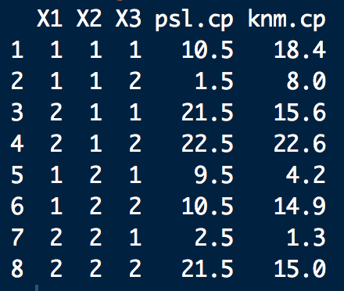
e.
# Node and edge beliefs:
psl.bel$node.bel
knm.bel$node.bel
psl.bel$edge.bel[[1]]
knm.bel$edge.bel[[1]]
psl.bel$edge.bel[[2]]
knm.bel$edge.bel[[2]]
psl.bel$edge.bel[[3]]
knm.bel$edge.bel[[3]]
# Configuration probabilities:
pot.info <- make.gRbase.potentials(psl, node.names = gp@nodes, state.nmes = c("1","2"))
gR.dist.info <- distribution.from.potentials(pot.info$node.potentials, pot.info$edge.potentials)
joint.dist.info <- as.data.frame(as.table(gR.dist.info$state.probs))
pot.info.knm <- make.gRbase.potentials(knm, node.names = gp@nodes, state.nmes = c("1","2"))
gR.dist.info.knm <- distribution.from.potentials(pot.info.knm$node.potentials,
pot.info.knm$edge.potentials)
joint.dist.info.knm <- as.data.frame(as.table(gR.dist.info.knm$state.probs))
psl.cp <- round(joint.dist.info[,4]*100, 1)
knm.cp <- round(joint.dist.info.knm[,4]*100, 1)
cbind(joint.dist.info[,c(2,3,1)], psl.cp, knm.cp)
Not too bad for only 25 samples:
Configuration probs (%)

Slide 180

Since we can construct a logistic regression that can be subjected to MLE for parameter estimates, there is nothing stopping us from doing a Bayesian logistic regression instead!
This gives us the added flexibility of including prior information for the parameters
For the Bayesian logistic regression, we’ll use Stan
A reasonable vague prior for the MRF parameters
The likelihoods for the
conditioned responses
The Stan computation to follow basically assumes you know how to use Stan. If not, see:
https://mc-stan.org/

Slide 181
Here is the logistic regression for the triangle model coded in Stan. Put it in a file called logistic_regression.stan. We’ll load it 6 slides from now.
data{
int<lower=0> N;
int<lower=-1,upper=1> X1[N]; //Delta-alpha vectors for each parameter
int<lower=-1,upper=1> X2[N];
int<lower=-1,upper=1> X3[N];
int<lower=-1,upper=1> X4[N];
int<lower=-1,upper=1> X5[N];
int<lower=-1,upper=1> X6[N];
int<lower=0,upper=1> y[N]; //Node responses
}
parameters{
vector[6] beta; //The MRF parameters
}
transformed parameters{
vector[N] Xbeta;
for (i in 1:N) // Form Delta theta (called beta here)
Xbeta[i] = beta[1]*X1[i] + beta[2]*X2[i] + beta[3]*X3[i] +
beta[4]*X4[i] + beta[5]*X5[i] + beta[6]*X6[i];
}
model{
beta ~ normal(0,100);
y ~ bernoulli_logit(Xbeta);
}

Slide 182
Here is the R code to execute the regression with Stan. First we begin just like the MLE estimation by setting up the model:
library(CRFutil)
library(rstan)
library(shinystan)
library(coda)
# Re-set up triangle model
grphf <- ~1:2+1:3+2:3
adj <- ug(grphf, result="matrix")
# Check the graph:
gp <- ug(grphf, result = "graph")
dev.off()
iplot(gp)
f0 <- function(y){ as.numeric(c((y==1),(y==2)))}
n.states <- 2

Slide 183
# Instantiate the "true model":
true.model <- make.crf(adj, n.states)
true.model <- make.features(true.model)
true.model <- make.par(true.model, 6)
true.model$node.par[1,1,] <- 1
true.model$node.par[2,1,] <- 2
true.model$node.par[3,1,] <- 3
true.model$edge.par[[1]][1,1,1] <- 4
true.model$edge.par[[1]][2,2,1] <- 4
true.model$edge.par[[2]][1,1,1] <- 5
true.model$edge.par[[2]][2,2,1] <- 5
true.model$edge.par[[3]][1,1,1] <- 6
true.model$edge.par[[3]][2,2,1] <- 6
set.seed(6)
true.model$par <- runif(6,-1.5,1.1)
true.model$par # "true" theta
out.pot <- make.pots(parms = true.model$par, crf = true.model, rescaleQ = T, replaceQ = T)
# So now sample from the true model as if we obtained an experimental sample:
num.samps <- 25
set.seed(1)
samps <- sample.exact(true.model, num.samps)
mrf.sample.plot(samps)

Slide 184
# Instantiate an empty model for the Bayesian fit:
bayes.lrm <- make.crf(adj, n.states)
bayes.lrm <- make.features(bayes.lrm)
bayes.lrm <- make.par(bayes.lrm, 6)
bayes.lrm$node.par[1,1,] <- 1
bayes.lrm$node.par[2,1,] <- 2
bayes.lrm$node.par[3,1,] <- 3
bayes.lrm$edge.par[[1]][1,1,1] <- 4
bayes.lrm$edge.par[[1]][2,2,1] <- 4
bayes.lrm$edge.par[[2]][1,1,1] <- 5
bayes.lrm$edge.par[[2]][2,2,1] <- 5
bayes.lrm$edge.par[[3]][1,1,1] <- 6
bayes.lrm$edge.par[[3]][2,2,1] <- 6
bayes.lrm$edges

Slide 185
# Instantiate an empty model for the MLE fit:
mle.lrm <- make.crf(adj, n.states)
mle.lrm <- make.features(mle.lrm)
mle.lrm <- make.par(mle.lrm, 6)
mle.lrm$node.par[1,1,] <- 1
mle.lrm$node.par[2,1,] <- 2
mle.lrm$node.par[3,1,] <- 3
mle.lrm$edge.par[[1]][1,1,1] <- 4
mle.lrm$edge.par[[1]][2,2,1] <- 4
mle.lrm$edge.par[[2]][1,1,1] <- 5
mle.lrm$edge.par[[2]][2,2,1] <- 5
mle.lrm$edge.par[[3]][1,1,1] <- 6
mle.lrm$edge.par[[3]][2,2,1] <- 6

Slide 186
# Set up the Delta-alpha matrix and requisite data to pass to Stan:
Delta.alpha.info <- delta.alpha(crf = bayes.lrm, samples = samps, printQ = F)
Delta.alpha <- Delta.alpha.info$Delta.alpha
y <-c(samps[,1], samps[,2], samps[,3])
y[which(y==2)] <- 0
y
dat <- list(
N=length(y),
X1=Delta.alpha[,1],
X2=Delta.alpha[,2],
X3=Delta.alpha[,3],
X4=Delta.alpha[,4],
X5=Delta.alpha[,5],
X6=Delta.alpha[,6],
y = y
)

Slide 187
# Compile and run the Stan model:
model.c <- stanc(file =
"logistic_model.stan",
model_name = 'model')
sm <- stan_model(stanc_ret = model.c, verbose = T)
# Run and diagnost the Stan model
rstan_options(auto_write = TRUE)
options(mc.cores = parallel::detectCores())
bfit <- sampling(sm, data = dat,
#control = list(adapt_delta = 0.85),
iter=20000,
thin = 10,
chains = 8)
print(bfit)
launch_shinystan(bfit)

Slide 188
# Re-run the MLE estimate:
Ma <- glm(
y ~ Delta.alpha[,1] +
Delta.alpha[,2] +
Delta.alpha[,3] +
Delta.alpha[,4] +
Delta.alpha[,5] +
Delta.alpha[,6] - 1,
family=binomial(link="logit"))
summary(Ma)

Slide 189
# Compare the Bayes, and MLE with the True model:
bayes.lrm$par <- c(median(beta[,1]), median(beta[,2]), median(beta[,3]), median(beta[,4]), median(beta[,5]), median(beta[,6]))
mle.lrm$par <- as.numeric(coef(Ma))
out.pot2 <- make.pots(parms = bayes.lrm$par, crf = bayes.lrm, rescaleQ = T, replaceQ = T)
out.pot2a <- make.pots(parms = mle.lrm$par, crf = mle.lrm, rescaleQ = T, replaceQ = T)
# Compare node and edge beliefs:
bayes.lrm.bel <- infer.exact(bayes.lrm)
mle.lrm.bel <- infer.exact(mle.lrm)
true.model.bel <- infer.exact(true.model)
bayes.lrm.bel$node.bel
mle.lrm.bel$node.bel
true.model.bel$node.bel
bayes.lrm.bel$edge.bel[[1]]
mle.lrm.bel$edge.bel[[1]]
true.model.bel$edge.bel[[1]]
bayes.lrm.bel$edge.bel[[2]]
mle.lrm.bel$edge.bel[[2]]
true.model.bel$edge.bel[[2]]
bayes.lrm.bel$edge.bel[[3]]
mle.lrm.bel$edge.bel[[3]]
true.model.bel$edge.bel[[3]]

Slide 190
# True configuration probabilities:
pot.info.true.model <- make.gRbase.potentials(true.model, node.names = gp@nodes,
state.nmes = c("1","2"))
gR.dist.info.true.model <- distribution.from.potentials(pot.info.true.model$node.potentials,
pot.info.true.model$edge.potentials)
logZ.true.model <- gR.dist.info.true.model$logZ
joint.dist.info.true.model <- as.data.frame(as.table(gR.dist.info.true.model$state.probs))
# Bayes configuration probabilities:
pot.info <- make.gRbase.potentials(bayes.lrm, node.names = gp@nodes,
state.nmes = c("1","2"))
gR.dist.info <- distribution.from.potentials(pot.info$node.potentials,
pot.info$edge.potentials)
logZ <- gR.dist.info$logZ
joint.dist.info <- as.data.frame(as.table(gR.dist.info$state.probs))
# MLE configuration probabilities:
pot.info2 <- make.gRbase.potentials(mle.lrm, node.names = gp@nodes,
state.nmes = c("1","2"))
gR.dist.info2 <- distribution.from.potentials(pot.info2$node.potentials,
pot.info2$edge.potentials)
logZ2 <- gR.dist.info2$logZ
joint.dist.info2 <- as.data.frame(as.table(gR.dist.info2$state.probs))
# Compare logistic regression based config probs from Bayes and MLE
# with the true config probs:
bayes.lrm.cp <- round(joint.dist.info[,4]*100, 1) # Bayes logistic
mle.lrm.cp <- round(joint.dist.info2[,4]*100, 1) # MLE logistic
true.model.cp <- round(joint.dist.info.true.model[,4]*100, 1) # True
cbind(joint.dist.info[,c(2,3,1)], bayes.lrm.cp, mle.lrm.cp, true.model.cp)

Slide 191
> cbind(joint.dist.info[,c(2,3,1)], bayes.lrm.cp, mle.lrm.cp, true.model.cp)
X1 X2 X3 bayes.lrm.cp mle.lrm.cp true.model.cp
1 1 1 1 10.3 10.5 18.4
2 1 1 2 1.1 1.5 8.0
3 2 1 1 22.0 21.5 15.6
4 2 1 2 23.1 22.5 22.6
5 1 2 1 9.1 9.5 4.2
6 1 2 2 10.3 10.5 14.9
7 2 2 1 2.0 2.5 1.3
8 2 2 2 22.0 21.5 15.0
>
The logistic Bayes and the MLE results are in pretty good agreement.
Again, both estimates are in pretty decent agreement with the true results considering that we only used 25 samples in the estimations.

Slide 192
Log-Linear Approach To Fit MRF Parameters

Slide 193

Lauritzen et al. General Log-Linear Approach
Lets go back to considering the exact log probability of each configuration X
  Recall:
This time lets fold all N observed configurations into a p-way contingency table
  E.g. for a 5D X of an Ising-like model p = 5 and the contingency table would be 2⁵ = 2× 2× 2× 2× 2
  Generally for Ising-like models can be represented in a 2^{p} = N dimensional contingency table.
The i^{th}, j^{th}, k^{th}, … element of the contingency table counts the number of times configuration state X_{n} occurred
  This is just a Poisson random variate!

Slide 194
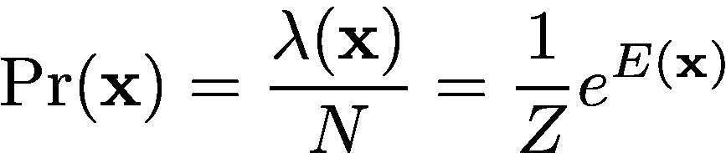

Lauritzen et al. General Log-Linear Approach
Each possible configuration X_{n} occurs with some rate λ(X_{n} )
We can thus write the probability of a configuration as
Taking logs and rearranging:
This can be fit with Poisson regression

Slide 195
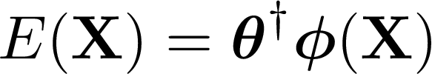

Recall the N by w model matrix for an MRF with respect to all possible configurations (not the sample):
θ₁
θ₂
θ_{w}
X₁
X₂
X_{N}
Note: N in this case is the total number of possible configs, and is not the sample size
Since the energy of a configuration, X is:
we can write the energies of all configurations as:

Slide 196



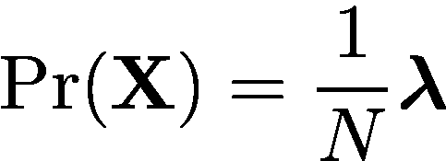

This allows us to write the (log) Poisson rates for each configuration as:
We can fit this with any mode of Poisson regression that we want!
  With estimates for θ and α in hand, we can recover:
Poisson rates for each config x
probability for each config x
(log) partition function
Note: N on this slide is the sample size (as usual)

Slide 197
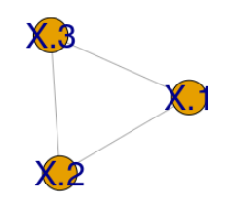
Again, lets examine the triangle model. Compare Bayesian Poisson regression results for the configuration probabilities to those obtained with MLE and logistic regression:
library(rstan)
library(CRFutil)
# Triangle model
grphf <- ~X.1:X.2+X.1:X.3+X.2:X.3
adj <- ug(grphf, result="matrix")
# Use the same "true" theta and seeds as with previous triange examples:
trit <- make.empty.field(adj.mat = adj, parameterization.typ = "standard")
set.seed(6)
trit$par <- runif(6,-1.5,1.1)
trit$par
# Chek: "true" theta should be:
#0.07629757 0.93786913 -0.81268462 -0.51175581 0.59945681 1.04299689
# Instantiate potentials
out.pot <- make.pots(parms = trit$par, crf = trit, rescaleQ = F, replaceQ = T)
# Now sample
set.seed(1)
num.samps <- 25
samps <- sample.exact(trit, num.samps)
mrf.sample.plot(samps)

Slide 198
OK, now that we have the same sample as before lets do the fit
The Stan model for a vanilla Poisson regression we’ll use is:
poisson_model.stan
data{
int p; // Number of columns in the model matrix = number of parameters
int N; // Number of configurations
int <lower=0> y[N]; // Counts of each configuration
matrix [N,p] Mmodl; // Model matrix for the graph
}
parameters{
vector [p] theta; // Regression coefs.
real alpha; // alpha intercept
}
model{
// Priors
theta ~ cauchy(0,30);
alpha ~ cauchy(0,10);
target += poisson_log_lpmf(y | alpha + Mmodl*theta);
}
We’ll use Cauchy priors for the parameters

Slide 199
# Make state count freq table from samples and compute frequencies of all
# possible state configs.
ftab <- data.frame(ftable(data.frame(samps)))
X.all <- ftab[,1:ncol(samps)]
freqs <- ftab[,ncol(ftab)]
# Model Matrix with respect to graph
f0 <- function(y){ as.numeric(c((y==1),(y==2)))}
M <- compute.model.matrix(configs=X.all, edges.mat=trit$edges,
node.par = trit$node.par, edge.par = trit$edge.par,
ff = f0)
# Fit log(lam) = alp + M theta
options(mc.cores = parallel::detectCores())
rstan_options(auto_write = TRUE)
model.c <- stanc(file = "poisson_model.stan", model_name = 'model')
sm <- stan_model(stanc_ret = model.c, verbose = T)
dat <- list(
p = ncol(M),
N = nrow(M),
y = freqs,
Mmodl = M
)
bfit <- sampling(sm, data = dat, iter=20000, thin = 4, chains = 4)

Slide 200
# Get the parameter estimates:
theta <- extract(bfit, "theta")[[1]]
alpha <- extract(bfit, "alpha")[[1]]
# Extract the graph's partition function:
N <- nrow(samps)
logZ <- log(N) - alpha
hist(logZ)
# Now using the (medians) posterior theta, estimate partition
# function with Belief propegation
llm2 <- make.empty.field(adj.mat = adj, parameterization.typ = "standard")
llm2$par <- apply(theta, MARGIN = 2, FUN = median)
out.pot <- make.pots(parms = llm2$par, crf = llm2, rescaleQ = F, replaceQ = T)
pot.info.llm2.model <- make.gRbase.potentials(llm2, node.names = c("X.1", "X.2", "X.3"),
state.nmes = c("1","2"))
gR.dist.info.llm2.model <- distribution.from.potentials(pot.info.llm2.model$node.potentials,
pot.info.llm2.model$edge.potentials)
logZ.llm2.model <- gR.dist.info.llm2.model$logZ
logZ.llm2.model # log partition function from BP with a theta (from regression)
mean(logZ) # log partition function direct from log linear regression
median(logZ)
joint.dist.info.llm2.model <- as.data.frame(as.table(gR.dist.info.llm2.model$state.probs))
joint.dist.info.llm2.model <- joint.dist.info.llm2.model[,c(2,3,1,4)]
joint.dist.info.llm2.model[,4] <- joint.dist.info.llm2.model[,4] * 100
joint.dist.info.llm2.model

Slide 201
Configuration Probabilities
Config. # | X |  |  | Bayes Poisson | Bayes Logistic | MLE Logistic | MLE | True Values
1 | 1 | 1 | 1 | 10.0 | 10.3 | 10.5 | 10.5 | 18.4
2 | 1 | 1 | 2 | 0.9 | 1.1 | 1.5 | 1.5 | 8
3 | 2 | 1 | 1 | 22.5 | 22 | 21.5 | 21.5 | 15.6
4 | 2 | 1 | 2 | 23.7 | 23.1 | 22.5 | 22.5 | 22.6
5 | 1 | 2 | 1 | 8.9 | 9.1 | 9.5 | 9.5 | 4.2
6 | 1 | 2 | 2 | 10.0 | 10.3 | 10.5 | 10.5 | 14.9
7 | 2 | 2 | 1 | 1.7 | 2 | 2.5 | 2.5 | 1.3
8 | 2 | 2 | 2 | 22.1 | 22 | 21.5 | 21.5 | 15
Again, estimates are in decent agreement with the true results considering that we only used 25 samples in the estimations.

Slide 202
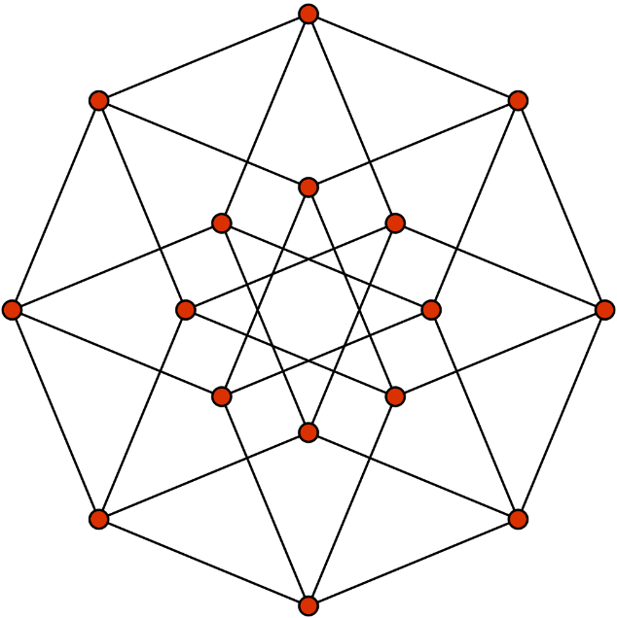
Here is a more challenging graph. Consider a tesseract. We will use 500 samples from a “true model” and check the log linear fit against it:
z
Irrelevant but fun note: this is also a 3D projection of a 4D cube
16 vertices
65,526 possible configs in Ising type model
x
Credit: Tom Ruen/Wiki
y
t

Slide 203
library(rstan)
library(shinystan)
library(CRFutil)
# Tesseract field model:
grphf <-
~X.1:X.2 + X.1:X.4 + X.1:X.5 + X.1:X.13 +
X.2:X.3 + X.2:X.6 + X.2:X.14 +
X.3:X.4 + X.3:X.7 + X.3:X.15 +
X.4:X.8 + X.4:X.16 +
X.5:X.6 + X.5:X.8 + X.5:X.9 +
X.6:X.7 + X.6:X.10 +
X.7:X.8 + X.7:X.11 +
X.8:X.12 +
X.9:X.10 + X.9:X.12 + X.9:X.13 +
X.10:X.11 + X.10:X.14 +
X.11:X.12 + X.11:X.15 +
X.12:X.16 +
X.13:X.14 + X.13:X.16 +
X.14:X.15 +
X.15:X.16
adj <- ug(grphf, result="matrix")
node2nme <- data.frame(1:ncol(adj),colnames(adj))
colnames(node2nme) <- c("node","name")
node.names <- colnames(adj)
gp <- ug(grphf, result = "graph")
dev.off()
iplot(gp)

Slide 204
“True” tesseract joint distribution
# Generate the "true" tesseract model
f0 <- function(y){ as.numeric(c((y==1),(y==2)))}
tess <- make.empty.field(adj.mat = adj, parameterization.typ = "standard", plotQ = T)
set.seed(87)
tess$par <- runif(tess$n.par,-1.5,1.5)
out.pot <- make.pots(parms = tess$par, crf = tess, rescaleQ = F, replaceQ = T)
# Compute "true" joint distribution
gR.tess <- make.gRbase.potentials(tess, node.names = node.names,
state.nmes = c("1","2"))
gR.dist.info.fit.model <- distribution.from.potentials(gR.tess$node.potentials,
gR.tess$edge.potentials)
joint.dist <- as.data.frame(as.table(gR.dist.info.fit.model$state.probs))
# Rearrange columns (node states) to be in the same order as in node.names
scrambled.nn <- colnames(joint.dist)[1:(ncol(joint.dist)-1)]
rearr.idxs <- sapply(1:length(node.names), function(xx){
which(scrambled.nn == node.names[xx])})
joint.dist.rearr <- joint.dist[c(rearr.idxs,ncol(joint.dist))]
# Convert configs to binary vectors and then to integers. These integers will be their indices
joint.configs <- joint.dist.rearr[,-ncol(joint.dist.rearr)]
joint.configs <- as.matrix(joint.configs)
joint.configs[which(joint.configs == 2, arr.ind = T)] <- 0
nn <- length(node.names)
powers.of.two <- 2^(0:(nn - 1))
joint.config.idxs <- sapply(1:nrow(joint.configs),function(xx){
as.integer(as.numeric(joint.configs[xx,]) %*% powers.of.two)})
# Order joint.config.idxs into decreasing order
joint.configs.row.order <- order(joint.config.idxs, decreasing = T)

Slide 205
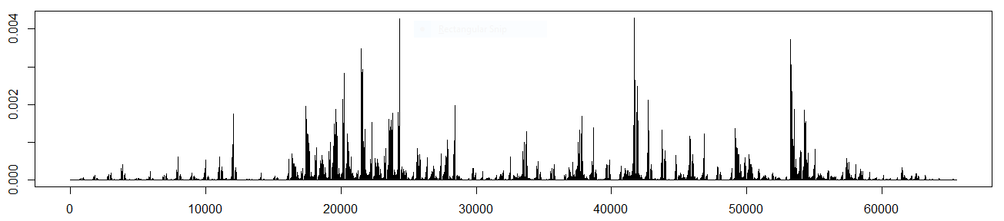
“True” tesseract joint distribution
config.prs <- joint.dist.rearr[,ncol(joint.dist.rearr)]
plot(config.prs[joint.configs.row.order], typ="h")
joint.dist.info.ordered <- data.frame(joint.config.idxs[joint.configs.row.order],
joint.configs[joint.configs.row.order,],
config.prs[joint.configs.row.order])
colnames(joint.dist.info.ordered) <- c("config.idx", node.names,"config.Pr")
head(joint.dist.info.ordered) # Check
sum(config.prs[joint.configs.row.order]) # config probs sum to 1?
“True” Configuration Probabilities (Joint Distribution)
Configuration Index

Slide 206
Log-linear tesseract joint distribution
library(rstan)
library(shinystan)
library(CRFutil)
# Fit the Bayes Poisson model to get estimates for theta
# First regenerate the reference sample
f0 <- function(y){ as.numeric(c((y==1),(y==2)))}
tess <- make.empty.field(adj.mat = adj, parameterization.typ = "standard", plotQ = T)
set.seed(87)
tess$par <- runif(tess$n.par,-1.5,1.5)
num.samps <- 500
set.seed(1)
samps <- sample.exact(tess, num.samps)
node.names <- colnames(adj)
node.names
colnames(samps) <- node.names
# Compute frequencies of all possible configs:
# State configs not observed will have 0 freq
ftab <- data.frame(ftable(data.frame(samps)))
X.all <- ftab[,1:ncol(samps)]
freqs <- ftab[,ncol(ftab)]
# CAUTION SLOW!: Model Matrix with respect to graph:
M <- compute.model.matrix(configs=X.all, edges.mat=tess$edges, node.par = tess$node.par,
edge.par = tess$edge.par, ff = f0)
dim(M) # Check: num rows = 2^nodes??

Slide 207
Log-linear tesseract joint distribution
options(mc.cores = parallel::detectCores())
rstan_options(auto_write = TRUE)
# CAUTION SLOW! Took 2h w/8cores on an i9: Fit log(lam) = alp + M theta
model.c <- stanc(file = "poisson_model.stan", model_name = 'model')
sm <- stan_model(stanc_ret = model.c, verbose = T)
dat <- list(
p = ncol(M),
N = nrow(M),
y = freqs,
Mmodl = M
)
dat
bfit <- sampling(sm, data = dat, iter=2000, thin = 1, chains = 8)
#launch_shinystan(bfit)
N <- nrow(samps)
theta <- extract(bfit, "theta")[[1]]
alpha <- extract(bfit, "alpha")[[1]]
# Use median of posterior estimate
theta.est <- apply(X = theta, MARGIN = 2, FUN = median)
alpha.est <- median(alpha)
logZ.est <- log(N) - alpha.est # Just for check/comparison later

Slide 208
Log-linear tesseract joint distribution
# Plunk estimated theta info a CRF model and compute the joint distribution
f0 <- function(y){ as.numeric(c((y==1),(y==2)))}
llm <- make.empty.field(adj.mat = adj, parameterization.typ = "standard", plotQ = T)
llm$par <- theta.est # use Stan median
out.pot <- make.pots(parms = llm$par, crf = llm, rescaleQ = F, replaceQ = T)
gR.llm <- make.gRbase.potentials(llm, node.names = node.names, state.nmes = c("1","2"))
gR.dist.info.llm.model <- distribution.from.potentials(gR.llm$node.potentials,
gR.tess$edge.potentials)
logZ.llm.model <- gR.dist.info.llm.model$logZ
joint.llm <- as.data.frame(as.table(gR.dist.info.llm.model$state.probs))
# Rearrange columns (node states) to be in the same order as in node.names
scrambled.nn <- colnames(joint.llm)[1:(ncol(joint.llm)-1)]
rearr.idxs <- sapply(1:length(node.names), function(xx){
which(scrambled.nn == node.names[xx])})
joint.llm.rearr <- joint.llm[c(rearr.idxs,ncol(joint.llm))]
# Convert configs to binary vectors and then to integers. These integers will be their indices
joint.configs <- joint.llm.rearr[,-ncol(joint.llm.rearr)]
joint.configs <- as.matrix(joint.configs)
joint.configs[which(joint.configs == 2, arr.ind = T)] <- 0
nn <- length(node.names)
powers.of.two <- 2^(0:(nn - 1))
joint.config.idxs <- sapply(1:nrow(joint.configs),function(xx){
as.integer(as.numeric(joint.configs[xx,]) %*% powers.of.two)})

Slide 209
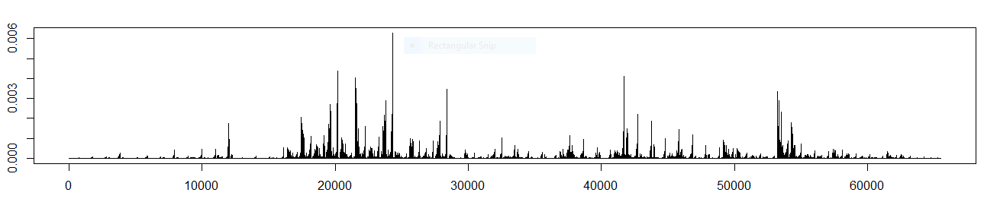
Log-linear tesseract joint distribution
# Order joint.config.idxs into decreasing order
joint.configs.row.order <- order(joint.config.idxs, decreasing = T)
config.prs <- joint.dist.rearr[,ncol(joint.dist.rearr)]
plot(config.prs[joint.configs.row.order], typ="h")
joint.dist.info.ordered <- data.frame(joint.config.idxs[joint.configs.row.order],
joint.configs[joint.configs.row.order,],
config.prs[joint.configs.row.order])
colnames(joint.dist.info.ordered) <- c("config.idx", node.names,"config.Pr")
head(joint.dist.info.ordered) # Check
sum(config.prs[joint.configs.row.order]) # config probs sum to 1?
Log Linear Configuration Probabilities (Joint Distribution)
Configuration Index

Slide 210
Maximum likelihood tesseract joint distribution
library(CRFutil)
# Fit the MLE model to get estimates for theta
# First regenerate the reference sample yet again
f0 <- function(y){ as.numeric(c((y==1),(y==2)))}
tess <- make.empty.field(adj.mat = adj, parameterization.typ = "standard", plotQ = T)
set.seed(87)
tess$par <- runif(tess$n.par,-1.5,1.5)
num.samps <- 500
set.seed(1)
samps <- sample.exact(tess, num.samps)
node.names <- colnames(adj)
colnames(samps) <- node.names
# Fit the model to the sample with MLE:
mle <- make.empty.field(adj.mat = adj, parameterization.typ = "standard")
# Auxiliary, gradient convenience function. Follows train.mrf in CRF:
gradient <- function(par, crf, ...) { crf$gradient }
mle$par.stat <- mrf.stat(mle, samps) # requisite sufficient statistics
infr.meth <- infer.exact # inference method needed for Z and marginals calcs
opt.info <- stats::optim( # optimize parameters
par = mle$par, # theta
fn = negloglik, # objective function
gr = gradient, # grad of obj func
crf = mle, # passed to fn/gr
samples = samps, # passed to fn/gr
infer.method = infr.meth, # passed to fn/gr
update.crfQ = TRUE, # passed to fn/gr
method = "L-BFGS-B",
control = list(trace = 1, REPORT=1))

Slide 211
Maximum likelihood tesseract joint distribution
# Checks: May have to re-run optimize a few times to get gradient down:
opt.info$convergence
opt.info$message
tess$gradient
tess$nll
tess$par
# Now compute the joint dist from the estimated theta
out.pot <- make.pots(parms = mle$par, crf = mle, rescaleQ = F, replaceQ = T)
gR.mle <- make.gRbase.potentials(mle, node.names = node.names, state.nmes = c("1","2"))
gR.dist.info.mle.model <- distribution.from.potentials(gR.mle$node.potentials,
gR.mle$edge.potentials)
logZ.mle.model <- gR.dist.info.mle.model$logZ
joint.mle <- as.data.frame(as.table(gR.dist.info.mle.model$state.probs))
# Rearrange columns (node states) to be in the same order as in node.names
scrambled.nn <- colnames(joint.mle)[1:(ncol(joint.mle)-1)]
rearr.idxs <- sapply(1:length(node.names), function(xx){
which(scrambled.nn == node.names[xx])})
joint.mle.rearr <- joint.mle[c(rearr.idxs,ncol(joint.mle))]
# Convert configs to binary vectors and then to integers. These integers will be their indices
joint.configs <- joint.mle.rearr[,-ncol(joint.mle.rearr)]
joint.configs <- as.matrix(joint.configs)
joint.configs[which(joint.configs == 2, arr.ind = T)] <- 0
nn <- length(node.names)
powers.of.two <- 2^(0:(nn - 1))
joint.config.idxs <- sapply(1:nrow(joint.configs),function(xx){
as.integer(as.numeric(joint.configs[xx,]) %*% powers.of.two)})

Slide 212
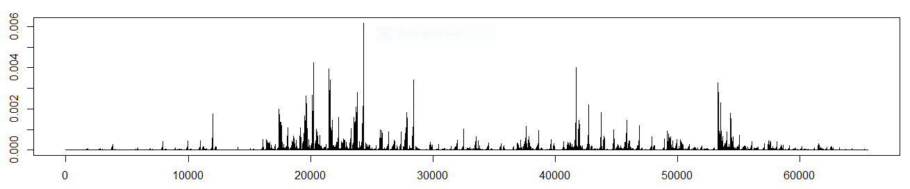
Maximum likelihood tesseract joint distribution
# Order joint.config.idxs into decreasing order
joint.configs.row.order <- order(joint.config.idxs, decreasing = T)
config.prs <- joint.dist.rearr[,ncol(joint.dist.rearr)]
plot(config.prs[joint.configs.row.order], typ="h")
joint.dist.info.ordered <- data.frame(joint.config.idxs[joint.configs.row.order],
joint.configs[joint.configs.row.order,],
config.prs[joint.configs.row.order])
colnames(joint.dist.info.ordered) <- c("config.idx", node.names,"config.Pr")
head(joint.dist.info.ordered) # Check
sum(config.prs[joint.configs.row.order]) # config probs sum to 1?
MLE Configuration Probabilities (Joint Distribution)
Configuration Index

Slide 213
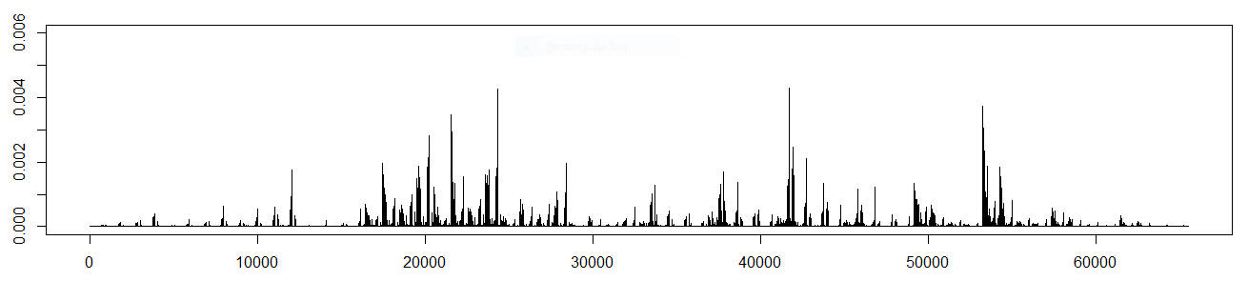
Tesseract joint distribution
True
Log Linear (Poisson)
MLE

Slide 214
Message Passing and Belief Propagation

Slide 215
Belief Propagation
Belief propagation (BP) is all about marginalization on a graph (i.e. a graphical model).
BP is a clever re-organization of sums of products to achieve certain marginalizations
  BP is a message-passing algorithm
The marginalizations reachable depend on the parameterization of the graph.
  For pair-wise MRFs, we can reach node and edge marginals with BP as I’ll illustrate in gory detail next.

Slide 216
Belief Propagation
Y₁
Ψ₁
Consider a general factor graph chunk:
Ψ₂
Y₂
X
Ψ_{ο}
…
…
Ψ_{i}
Y_{j}
…
…

Slide 217
Message Recipes
Y₁
Ψ₁
Ψ₂
Y₂
X
Ψ_{ο}
…
…
Ψ_{i}
Variable to factor rule:
Y_{j}
…
…

Slide 218
Message Recipes
Y₁
Ψ₁
Ψ₂
Y₂
X
Ψ_{ο}
…
…
Ψ_{i}
Variable to factor rule:
Y_{j}
…
…

Slide 219
Message Recipes
Y₁
Ψ₁
Ψ₂
Y₂
X
Ψ_{ο}
…
…
Ψ_{i}
Factor to variable:
Y_{j}
…
…

Slide 220
Message Recipes
Y₁
Ψ₁
Ψ₂
Y₂
X
Ψ_{ο}
…
…
Ψ_{i}
Factor to variable:
Y_{j}
…
…

Slide 221
Belief Propagation
A
B
Ψ_{Α}
A
Ψ_{ΑΒ}
B
Ψ_{Β}
Choose a root variable node

Slide 222
Belief Propagation
Pass messages up to root variable node:
1.
3.
2.
1.
Ψ_{Α}
A
Ψ_{ΑΒ}
B
Ψ_{Β}
Pass messages down to leaf factors nodes:
4.
4.
5.
6.
Ψ_{Α}
A
Ψ_{ΑΒ}
B
Ψ_{Β}

Slide 223
Belief Propagation
1.
1.
Ψ_{Α}
A
Ψ_{ΑΒ}
B
Ψ_{Β}

Slide 224
Belief Propagation
2.
Ψ_{Α}
A
Ψ_{ΑΒ}
B
Ψ_{Β}

Slide 225
Belief Propagation
3.
Ψ_{Α}
A
Ψ_{ΑΒ}
B
Ψ_{Β}

Slide 226
Belief Propagation
4.
4.
Ψ_{Α}
A
Ψ_{ΑΒ}
B
Ψ_{Β}

Slide 227
Belief Propagation
5.
Ψ_{Α}
A
Ψ_{ΑΒ}
B
Ψ_{Β}

Slide 228
Belief Propagation
6.
Ψ_{Α}
A
Ψ_{ΑΒ}
B
Ψ_{Β}

Slide 229
Determine a message passing schedule and compute the set of messages for the simple MRF:
A
B

Slide 230
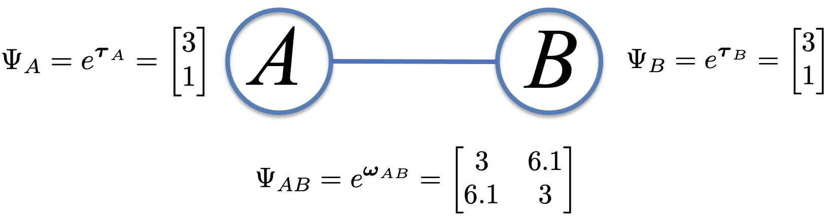
library(CRFutil)
library(Rgraphviz)
grf <- ~A:B
adj <- ug(grf, result="matrix")
f0 <- function(y){ as.numeric(c((y==1),(y==2)))}
n.states <- 2
km <- make.crf(adj, n.states)
# Node pots:
PsiA <- c(3,1)
PsiB <- c(3,1)
# Edge pots:
PsiAB <-
rbind(
c(3, 6.1),
c(6.1, 3)
)
km$node.pot[1,] <- PsiA
km$node.pot[2,] <- PsiB
km$edge.pot[[1]] <- PsiAB

Slide 231
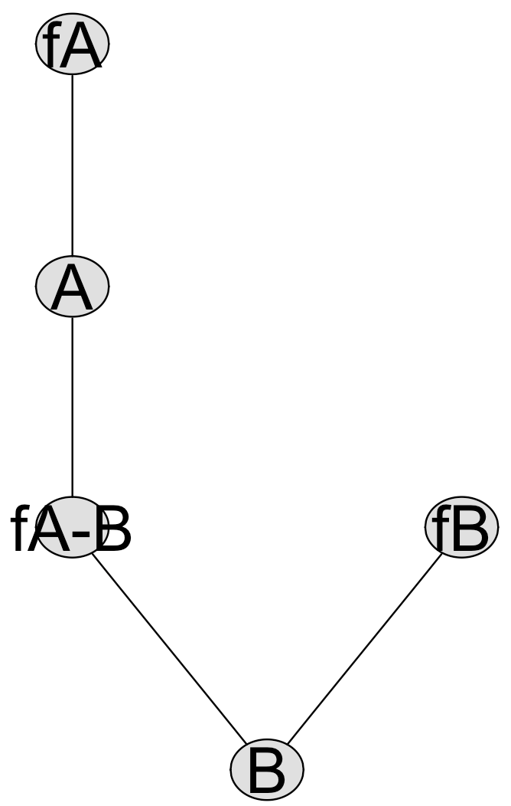
# Dress potentials for message passing:
gr.pots <- make.gRbase.potentials(crf = km, node.names = rownames(adj), state.nmes = c("up", "dn"))
all.pots <- union(gr.pots$node.potentials, gr.pots$edge.potentials)
# Put the same names on the potentials as will appear in the schedule:
nd.nms <- nodes(ug(grf)) # node names
edg.nms <- cbind(nd.nms[km$edges[,1]], nd.nms[km$edges[,2]]) # edge names
# Make formal potential names from node/edge names:
nd.pot.nms <- paste0("f", nd.nms)
edg.pot.nms <- paste0("f", nd.nms[km$edges[,1]], "-", nd.nms[km$edges[,2]])
names(all.pots) <- c(nd.pot.nms, edg.pot.nms)
# Messages will be passed on a factor graph, so convert MRF to a pair-wise factor graph:
pwfg <- mrf2pwfg(grf, plotQ=F)
dev.off()
plot(pwfg, nodeAttrs=makeNodeAttrs(pwfg, fontsize=30))
# Initialize a storage list to hold messages and get a message passing schedule:
# To work out a schedule we get lots of help from the graph and igraph packages. Check out the code in
# get.root.paths() and init.message.storage() for details.
root.node <- "A" # Pick any variable node as the root
root.pths <- get.root.paths(pwfg, root.node = "A", serial.schedsQ = T)
msg.cont.info <- init.message.storage(root.pths)
msg.bxs <- msg.cont.info$message.container # List to hold the messages (mailboxes)
msg.sch <- msg.cont.info$message.schedule.mat # Message passing schedule
Read! This is where the hard part of programing BP is: scheduling the message passes (specifically for graphs with no loops: trees)!

Slide 232
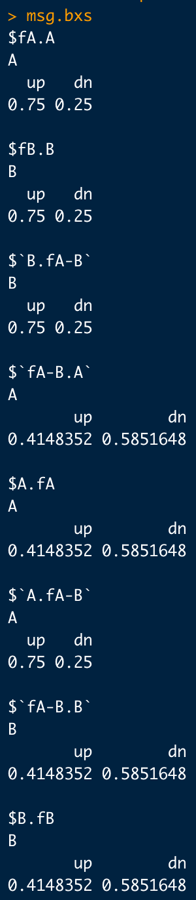
# Pass messages according to schedule:
for(i in 1:nrow(msg.sch)){
msg.num <- i
print(msg.sch[msg.num,]) # message info
msg.nd.nmes <- as.character(msg.sch[msg.num,c(2,3)]) # start-end nodes of message
# Pass a message:
msg.info <- pass.message(start.node = msg.nd.nmes[1],
end.node = msg.nd.nmes[2],
factor.graph = pwfg,
pots.list = all.pots,
mailboxes.list = msg.bxs,
printQ = F)
# Store the message computed:
msg.bxs[[msg.info$mailbox.idx]] <- msg.info$message
}
#All the computed messages:
msg.bxs

Slide 233
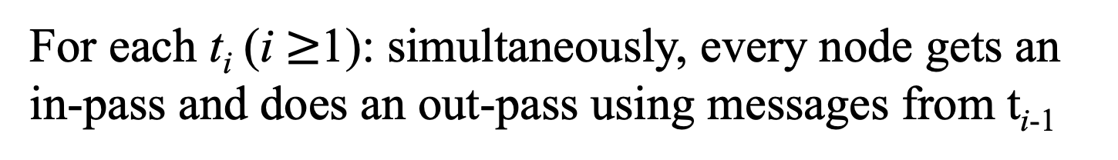
Loopy Belief Propagation
t_{i}
t_{i}
t_{i}
t_{i}
Ψ_{Α}
A
Ψ_{ΑΒ}
B
Ψ_{Β}
t_{i}
t_{i}
t_{i}
t_{i}
For each t_{i} (i $≥$1): simultaneously, every node gets an in-pass and does an out-pass using messages from t_{i-1}
At t₀:

Slide 234
Loopy Belief Propagation
Ψ_{Α}
A
Ψ_{ΑΒ}
B
Ψ_{Β}
t_{i}

Slide 235
Ψ_{Α}
A
t_{i}
…

Slide 236
Loopy Belief Propagation
t_{i}
t_{i}
Ψ_{Α}
A
Ψ_{ΑΒ}
B
Ψ_{Β}

Slide 237
t_{i}
Ψ_{Α}
A
…

Slide 238
t_{i}
A
Ψ_{ΑΒ}
…

Slide 239
Loopy Belief Propagation
t_{i}
Ψ_{Α}
A
Ψ_{ΑΒ}
B
Ψ_{Β}
t_{i}

Slide 240
A
Ψ_{ΑΒ}
t_{i}
…

Slide 241
t_{i}
Ψ_{ΑΒ}
B
…

Slide 242
Loopy Belief Propagation
t_{i}
Ψ_{Α}
A
Ψ_{ΑΒ}
B
Ψ_{Β}
t_{i}

Slide 243
Ψ_{ΑΒ}
B
t_{i}
…

Slide 244
t_{i}
B
Ψ_{Β}
…

Slide 245
Loopy Belief Propagation
Ψ_{Α}
A
Ψ_{ΑΒ}
B
Ψ_{Β}
t_{i}

Slide 246
B
Ψ_{Β}
t_{i}
…

Slide 247
Loopy BP should converge to the same messages as scheduled BP for trees. To try out loopy BP and demonstrate the convergence, try it out on the simple MRF used above
# Try loopy passes. Note: No root node choice necessary.
msg.cont.info.loopy <- init.loopy.message.storage(pwfg)
msg.bxs.loopy <- msg.cont.info.loopy$message.container
msg.sch.loopy <- msg.cont.info.loopy$message.schedule.mat
# Loopy Pass messages according to schedule:
max.iter <- 3
for(iter in 1:max.iter){
for(i in 1:nrow(msg.sch.loopy)){
msg.num <- i
print(msg.sch.loopy[msg.num,]) # message info
msg.nd.nmes <- as.character(msg.sch.loopy[msg.num,c(2,3)]) # start-end msg
msg.info <- pass.message(start.node = msg.nd.nmes[1],
end.node = msg.nd.nmes[2],
factor.graph = pwfg,
pots.list = all.pots,
mailboxes.list = msg.bxs.loopy,
printQ = F)
msg.bxs.loopy[[msg.info$mailbox.idx]] <- msg.info$message
}
print(paste("===== Loopy iteration:", iter, "done ====="))
}
msg.bxs.loopy
Schedule is much simpler to construct for loopy BP since all messages are initialized to id vectors and passed at the same time
The other major change is that we run BP a few times until we (hopefully) reach convergence. Trees (no-loops) should converge.

Slide 248

# Compare loopy messages to scheduled BP messages:
# Initialize a storage list to hold messages and get message passing schedule:
root.pths <- get.root.paths(pwfg, root.node = "A", serial.schedsQ = T)
msg.cont.info <- init.message.storage(root.pths)
msg.bxs <- msg.cont.info$message.container
msg.sch <- msg.cont.info$message.schedule.mat
# Pass messages according to schedule:
for(i in 1:nrow(msg.sch)){
msg.num <- i
print(msg.sch[msg.num,]) # message info
msg.nd.nmes <- as.character(msg.sch[msg.num,c(2,3)]) # start-end nodes of message
# Pass a message:
msg.info <- pass.message(start.node = msg.nd.nmes[1],
end.node = msg.nd.nmes[2],
factor.graph = pwfg,
pots.list = all.pots,
mailboxes.list = msg.bxs,
printQ = F)
# Store the message:
msg.bxs[[msg.info$mailbox.idx]] <- msg.info$message
}
msg.bxs
Because this MRF is a tree, scheduled serial and loopy messages are the same:

Slide 249
Marginals
Ψ₂
Ψ₁
X
…
Node beliefs can be computed as:
Ψ₃
…
Ψ_{i}

Slide 250
Marginals
Edge beliefs can be computed using:
Y₁
Ψ_{ο}
Y₂
(marginal for the set of variables connected to a factor)

Slide 251
Re-compute the scheduled serial messages for the simple two-node MRF to find the node and edge beliefs:
library(CRFutil)
library(Rgraphviz)
grf <- ~A:B
adj <- ug(grf, result="matrix")
n.states <- 2
km <- make.crf(adj, n.states)
# Node pots:
PsiA <- c(3,1)
PsiB <- c(3,1)
# Edge pots:
PsiAB <-
rbind(
c(3, 6.1),
c(6.1, 3)
)
km$node.pot[1,] <- PsiA
km$node.pot[2,] <- PsiB
km$edge.pot[[1]] <- PsiAB
# Dress potentials for message passing:
gr.pots <- make.gRbase.potentials(crf = km, node.names = rownames(adj), state.nmes = c("up", "dn"))
all.pots <- union(gr.pots$node.potentials, gr.pots$edge.potentials)
# Put the same names on the potentials as will appear in the schedule:
nd.nms <- nodes(ug(grf)) # node names
edg.nms <- cbind(nd.nms[km$edges[,1]], nd.nms[km$edges[,2]]) # edge names
# Make formal potential names from node/edge names:
nd.pot.nms <- paste0("f", nd.nms)
edg.pot.nms <- paste0("f", nd.nms[km$edges[,1]], "-", nd.nms[km$edges[,2]])
names(all.pots) <- c(nd.pot.nms, edg.pot.nms)

Slide 252
# Messages will be passed on a factor graph, so convert MRF to a pair-wise factor graph:
pwfg <- mrf2pwfg(grf, plotQ=F)
dev.off()
plot(pwfg, nodeAttrs=makeNodeAttrs(pwfg, fontsize=30))
# Initialize a storage list to hold messages and get a message passing schedule:
root.node <- "A" # Pick any variable node as the root
root.pths <- get.root.paths(pwfg, root.node = "A", serial.schedsQ = T)
msg.cont.info <- init.message.storage(root.pths)
msg.bxs <- msg.cont.info$message.container # List to hold the messages (mailboxes)
msg.sch <- msg.cont.info$message.schedule.mat # Message passing schedule
# Pass messages according to schedule:
for(i in 1:nrow(msg.sch)){
msg.num <- i
print(msg.sch[msg.num,]) # message info
msg.nd.nmes <- as.character(msg.sch[msg.num,c(2,3)]) # start-end nodes of message
# Pass a message:
msg.info <- pass.message(start.node = msg.nd.nmes[1],
end.node = msg.nd.nmes[2],
factor.graph = pwfg,
pots.list = all.pots,
mailboxes.list = msg.bxs,
printQ = F)
# Store the message computed:
msg.bxs[[msg.info$mailbox.idx]] <- msg.info$message
}

Slide 253


# Get exact marginals from CRF to check our computations against:
all.marginals <- infer.exact(km)
all.marginals
# Compute node marginals (node beliefs). Compare to those from CRF:
for(i in 1:length(nd.nms)){
ndm <- node.marginal(nd.nms[i], pwfg, msg.bxs)
print(paste0("bel(",nd.nms[i],"):"))
print(ndm)
print(round(ndm - all.marginals$node.bel[i,], 3)) # Diffs = about 0??
print("==================================")
}
# Compute edge marginals (edge beliefs). Compare to those from CRF:
for(i in 1:nrow(km$edges)){
lnd <- nd.nms[km$edges[i,1]]
rnd <- nd.nms[km$edges[i,2]]
print(paste0("bel(",lnd,",",rnd,"):"))
edgm <- edge.marginal(v.start.node = lnd, v.end.node = rnd,
factor.graph = pwfg, pots.list = all.pots, mailbox.list = msg.bxs)
print(edgm)
print(round(edgm - all.marginals$edge.bel[[i]], 3)) # Diffs = about 0??
print("==================================")
}

Slide 254

Just to prove it’ll work, run loopy belief propagation in the MRF to the right using random potentials and determine a set of node and edge beliefs:
library(CRFutil)
library(Rgraphviz)
# Loopy Message pass test on a graph with a loop:
# Model:
grf <- ~A:B + B:C + C:D + D:A
dev.off()
plot(ug(grf))
dev.off()
# First Instantiate a model with some random values for the params in the potentials:
adj <- ug(grf, result="matrix")
n.states <- 2
km <- sim.field.random(adjacentcy.matrix = adj, num.states = n.states, num.sims = 0, seed = 1)[[1]]
# Dress potentials for message passing:
gr.pots <- make.gRbase.potentials(crf = km, node.names = rownames(adj), state.nmes = c("up", "dn"))
ep <- gr.pots$edge.potentials # Edge potentials in gRbase format
np <- gr.pots$node.potentials # Node potentials in gRbase format
all.pots <- union(np, ep) # Put all node and edge potentials into one list
nd.nms <- nodes(ug(grf)) # node names
edg.nms <- cbind(nd.nms[km$edges[,1]], nd.nms[km$edges[,2]]) # edge names
nd.pot.nms <- paste0("f", nd.nms) # node potential names
edg.pot.nms <- paste0("f", nd.nms[km$edges[,1]], "-", nd.nms[km$edges[,2]]) # edge potential names
names(all.pots) <- c(nd.pot.nms, edg.pot.nms) # Put the same names on the potentials as will appear in the schedule

Slide 255

# Convert MRF to a pair-wise factor graph
pwfg <- mrf2pwfg(grf, plotQ=T)
dev.off()
plot(pwfg, nodeAttrs=makeNodeAttrs(pwfg, fontsize=30))
# Try loopy passes (no root node necessary):
msg.cont.info <- init.loopy.message.storage(pwfg)
msg.bxs <- msg.cont.info$message.container
msg.sch <- msg.cont.info$message.schedule.mat
# Loopy Pass messages according to schedule:
max.iter <- 30
for(iter in 1:max.iter){
for(i in 1:nrow(msg.sch)){
msg.num <- i
print(msg.sch[msg.num,]) # message info
msg.nd.nmes <- as.character(msg.sch[msg.num,c(2,3)]) # start-end nodes of message
msg.info <- pass.message(start.node = msg.nd.nmes[1],
end.node = msg.nd.nmes[2],
factor.graph = pwfg,
pots.list = all.pots,
mailboxes.list = msg.bxs,
printQ = F)
msg.bxs[[msg.info$mailbox.idx]] <- msg.info$message
}
print(paste("===== Loopy iteration:", iter, "done ====="))
}
msg.bxs

Slide 256


# Get exact marginals to check against:
all.marginals <- infer.exact(km)
all.marginals
# Node marginals
for(i in 1:length(nd.nms)){
ndm <- node.marginal(nd.nms[i], pwfg, msg.bxs)
print(paste0("bel(",nd.nms[i],"):"))
print(ndm)
print(round(ndm - all.marginals$node.bel[i,], 3)) # Diffs = about 0??
print("==================================")
}
# Edge marginals
for(i in 1:nrow(km$edges)){
lnd <- nd.nms[km$edges[i,1]]
rnd <- nd.nms[km$edges[i,2]]
print(paste0("bel(",lnd,",",rnd,"):"))
edgm <- edge.marginal(v.start.node = lnd, v.end.node = rnd,
factor.graph = pwfg, pots.list = all.pots, mailbox.list = msg.bxs)
print(edgm)
print(round(edgm - all.marginals$edge.bel[[i]], 3)) # Diffs = about 0??
print("==================================")
}
Not exact agreement with exact marginals, but loopy BP will often (but not always) produce decent approximations for the beliefs

Slide 257
Beneath Here I’m still working on it

Slide 258
Gibbs sampling, Conditional energy
Free Energy, Z, Yedidia??
Model (graph) Building from Data
gRim
Graphical lasso
MLE,Bayes pair tests
Sprites??
Conditional Independence

Slide 259
Predictive accuracy and Model Comparison

Slide 260
Model Selection: Graph Building From Data

