Slide 1

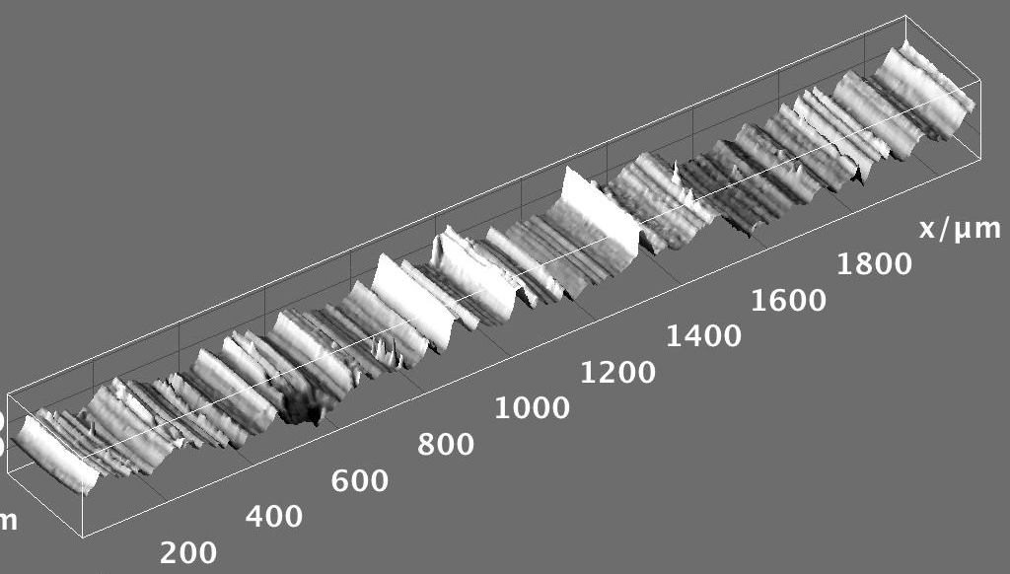


Hands-on Introduction to R

Slide 2
Outline
R : A powerful Platform for Statistical Analysis
  Why bother learning R ?
  Data, data, data, I cannot make bricks without clay ^{Copper Beeches}
    A tour of RStudio. Basic Input and Output
    Getting Help
    Loading your data from Excel spreadsheets
    Visualizing with Plots
  Basic Statistical Inference Tools
    Confidence Intervals
    Hypothesis Testing/ANOVA

Slide 3

Why ?
  R is not a black box!
    Codes available for review; totally transparent!
  R maintained by a professional group of statisticians, and computational scientists
    From very simple to state-of-the-art procedures available
    Very good graphics for exhibits and papers
  R is extensible (it is a full scripting language)
    Coding/syntax similar to Python and MATLAB
    Easy to link to C/C++ routines

Slide 4
Why ?
  Where to get information on R :
    R: http://www.r-project.org/
      Just need the base
    RStudio: http://rstudio.org/
      A great IDE for R
      Work on all platforms
      Sometimes slows down performance…
    CRAN: http://cran.r-project.org/
      Library repository for R
      Click on Search on the left of the website to search for package/info on packages

Slide 5
Finding our way around R/RStudio
Script Window
Command Line

Slide 6
Handy Commands:
  Basic Input and Output
Numeric input
x <- 4
variables:
store
information
:Assignment operator
x <- “text goes in quotes”
Text (character) input

Slide 7
Handy Commands:
Get help on an R command:
  If you know the name: ?command name
    ?plot brings up html on plot command
  If you don’t know the name:
    Use Google (my favorite)
    ??key word

Slide 8
Handy Commands:
R is driven by functions:
func(arguement1, argument2)
function name
input to function goes in parenthesis
function returns something; gets dumped into x
x <- func(arg1, arg2)

Slide 9
Handy Commands:
  Input from Excel
    Save spreadsheet as a CSV file
      Use read.csv function
      Needs the path to the file
Mac e.g.:
"/Users/npetraco/latex/papers/data.csv”
Windows e.g.:
“C:\Users\npetraco\latex\papers\data.csv”
*Exercise: basicIO.R

Slide 10
Handy Commands:
  Matrices: X
    X[,1] returns column 1 of matrix X
    X[3,] returns row 3 of matrix X
    Handy functions for data frames and matrices:
      dim, nrow, ncol, rbind, cbind
  User defined functions syntax:
    func.name <- function(arguements) {
    do something
    return(output)
    }
    To use it: func.name(values)

Slide 11
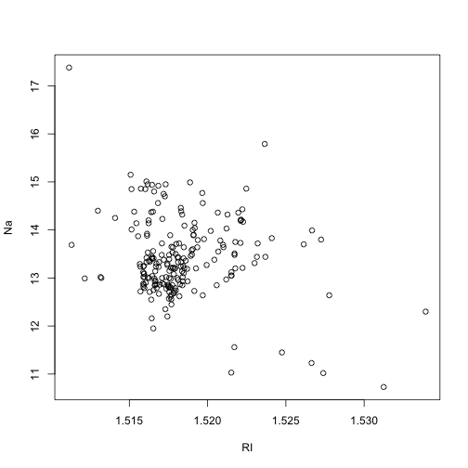
First Thing: Look at your Data
  Explore the Glass dataset of the mlbench package
    Source (load) all_data_source.R
    *visualize_with_plots.r
    Scatter plots: plot any two variables against each other

Slide 12
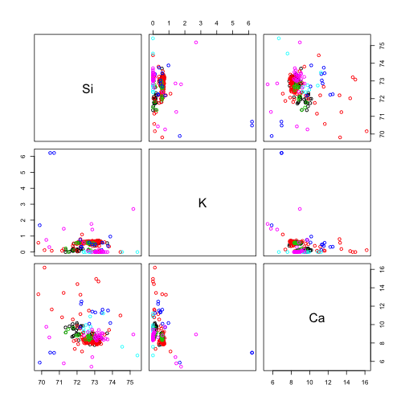
First Thing: Look at your Data
    Pairs plots: do many scatter plots at once

Slide 13
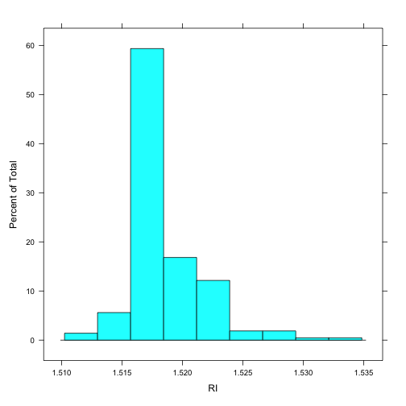
First Thing: Look at your Data
    Histograms: “bin” a variable and plot frequencies

Slide 14
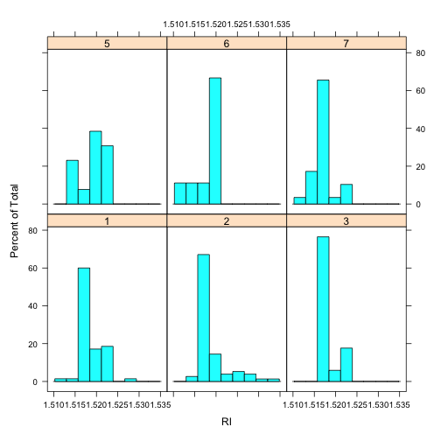
First Thing: Look at your Data
    Histograms conditioned on other variables: use lattice package
RIs Conditioned on glass group membership

Slide 15
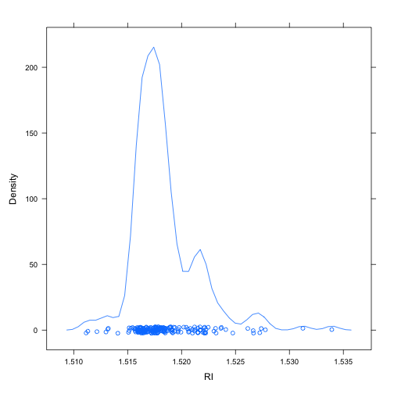
First Thing: Look at your Data
    Probability density plots: also needs lattice

Slide 16
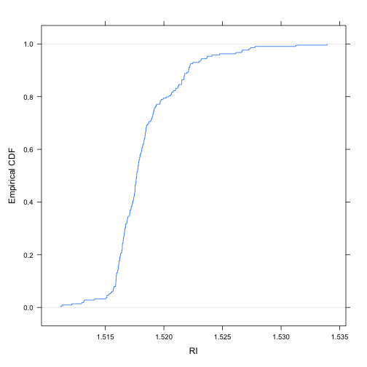
First Thing: Look at your Data
    Empirical Probability Distribution plots: also called empirical cumulative density

Slide 17
First Thing: Look at your Data
    Box and Whiskers plots:
range
possible
outliers
possible
outliers
25th-%tile
1st-quartile
median
50th-%tile
75th-%tile
3rd-quartile
RI

Slide 18
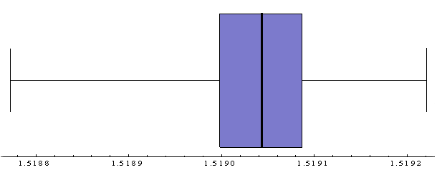
Visualizing Data
Note the relationship:

Slide 19
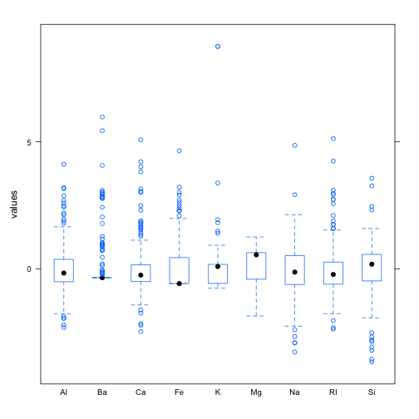
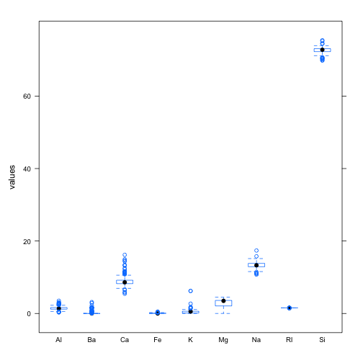
First Thing: Look at your Data
    Box and Whiskers plots:
Box-Whiskers plots for actual variable values
Box-Whiskers plots for scaled variable values

Slide 20
Confidence Intervals
A confidence interval (CI) gives a range in which a true population parameter may be found.
  Specifically, (1- )×100% CIs for a parameter, constructed from a random sample (of a given sample size), will contain the true value of the parameter approximately (1- )×100% of the time.
  Different from tolerance and prediction intervals

Slide 21
Confidence Intervals
  Caution: IT IS NOT CORRECT to say that there a (1- )×100% probability that the true value of a parameter is between the bounds of any given CI.
Take a sample.
Compute a CI.
Here 90% of the
CIs contain the
true value of the
parameter
Graphical representation of
90% CIs is for a parameter:
true value
of parameter

Slide 22
Confidence Intervals
Construction of a CI for a mean depends on:
  Sample size n
  Standard error for means
  Level of confidence 1-
    is significance level
    Use to compute t_{c}-value
  (1- )×100% CI for population mean using a sample average and standard error is:

Slide 23
Confidence Intervals
Compute a 99% confidence interval for the mean using this sample set:
Fragment # | Fragment nD
1 | 1.52005
2 | 1.52003
3 | 1.52001
4 | 1.52004
5 | 1.52000
6 | 1.52001
7 | 1.52008
8 | 1.52011
9 | 1.52008
10 | 1.52008
11 | 1.52008
( /2=0.005) t_{c} = 3.17
Putting this together:
[1.52005 - (3.17)(0.00001), 1.52005 + (3.17)(0.00001)]
99% CI for sample = [1.52002, 1.52009]
*Try out confidence_intervals.R

Slide 24
Hypothesis Testing
A hypothesis is an assumption about a statistic.
  Form a hypothesis about the statistic
    H₀, the null hypothesis
  Identify the alternative hypothesis, H_{a}
  “Accept” H₀ or “Reject” H₀ in favour of H_{a} at a certain confidence level (1- )×100%
    Technically, “Accept” means “Do not Reject”
    The testing is done with respect to how sample values of the statistic are distributed
      Student’s-t
      Gaussian
Binomial
Poisson
Bootstrap, etc.

Slide 25
Hypothesis Testing
Hypothesis testing can go wrong:
  1- is called test’s power
Do the thicknesses of float glass differ from non float glass?
  How can we use a computer to decide?
 | H₀ is really true | H₀ is really false
Test rejects H₀ | Type I error. Probability is | OK
Test accepts H₀ | OK | Type II error. Probability is

Slide 26
Analysis of Variance
Standard hypothesis testing is great for comparing two statistics.
  What is we have more than two statistics to compare?
    Use analysis of variance (ANOVA)
Note that the statistics to be compares must all be of the same type
  Usually the statistic is an average “response” for different experimental conditions or treatments.

Slide 27
Analysis of Variance
H₀ for ANOVA
  The values being compared are not statistically different at the (1- )×100% level of confidence
H_{a} for ANOVA
  At least one of the values being compared is statically distinct.
ANOVA computes an F-statistic from the data and compares to a critical F_{c} value for
  Level of confidence
  D.O.F. 1 = # of levels -1
  D.O.F. 2 = # of obs. - # of levels

Slide 28
Analysis of Variance
H₀ for ANOVA
  The values being compared are not statistically different at the (1- )×100% level of confidence
H_{a} for ANOVA
  At least one of the values being compared is statically distinct.
ANOVA computes an F-statistic from the data and compares to a critical F_{c} value for
  Level of confidence
  D.O.F. 1 = # of levels -1
  D.O.F. 2 = # of obs. - # of levels

Slide 29
Analysis of Variance
  Levels are “categorical variables” and can be:
    Group names
    Experimental conditions
    Experimental treatments
  Are the average RIs for each type of glass in the “Forensic Glass” data set statistically different?
Exercise: Try out anova.R

